Slide 1
FY 2013 HUB Report
Budget and Finance Committee
January 22, 2013
Tena Southwell

Slide 2
Eligible Expenditures
Expense Categories Not Included: benefits, claims and judgments, interfund transfers, interagency payments, investments, payment of interest, payment of principal, public assistance payments, rental and leases, utilities, salaries, wages, travel, grants, scholarships, real estate purchases, right-of-way, emergency abatement response, and other expenses as determined by the State of Texas Disparity Study.

Slide 3
HUB Eligible Expenditures Operating and CIP Expenses
Total Eligible Operating Expense | $ 2,941,077.72
Total HUB Operating Expenditure | $ 410,727.00
Percentage of HUB Operating Expenditure | 14.0%
Total Eligible CIP Expense | $ 966,968.45
Total HUB CIP Expenditure | $ 173,795.00
Percentage of HUB CIP Expenditure | 18.0%

Slide 4
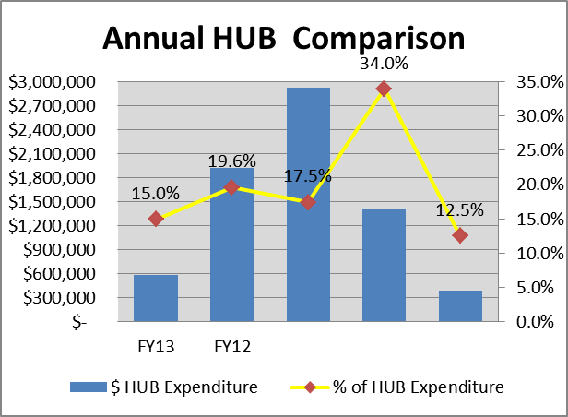
HUB Eligible Expenditures
Grand Total Eligible Expenditure | $ 3,908,046.17
Grand Total HUB Expenditure | $ 584,522.00
HUB as a Percentage of Total Eligible Expenditure | 15.0%
Central Health’s total HUB Expenditure for 2013 is $585k compared to $1.9M in 2012, which had high capital spending and more opportunity for HUB construction contracts.

Slide 5
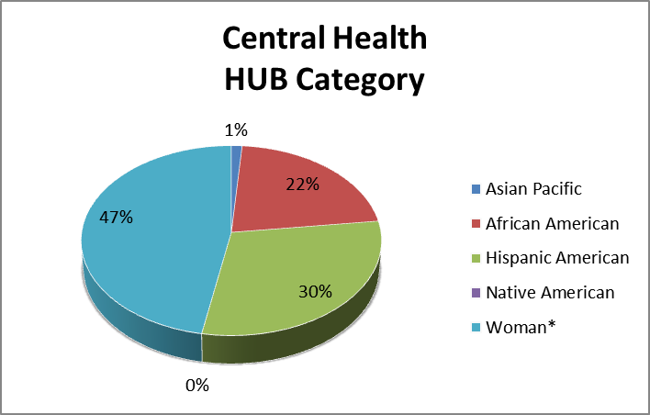
HUB Category

Slide 6
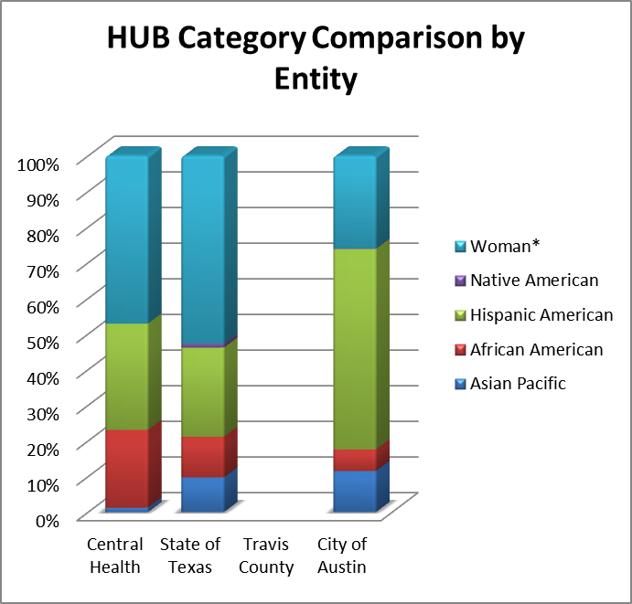
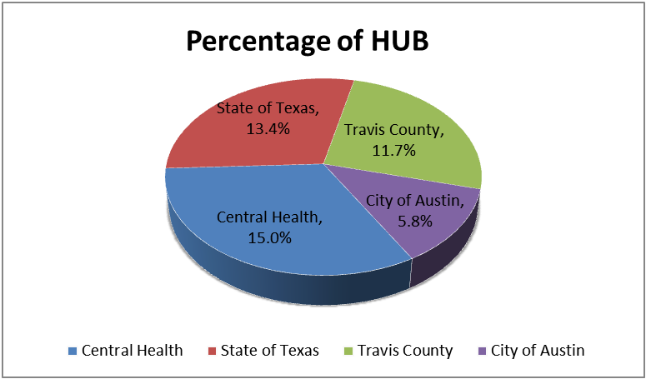
HUB Entity Comparison

Slide 7
Questions?

