Slide 1
FY 2014
Historically Underutilized Business Budget and Finance Committee February 18, 2015
Larry Wallace
Norma Williams

Slide 2
Central Health’s General Purchasing Policy
The Board of Managers approved Central Health’s Purchasing Policy, which states that a “good faith effort” must be made to assist certified Historically Underutilized Businesses (HUB) vendors and contractors in its award of contracts and subcontracts.

Slide 3
Definition of a HUB “Historically Underutilized Business”
A for-profit entity that has not exceeded the size standards prescribed by 34 TAC §20.23 (Texas Administrative Code), and has its principal place of business in Texas, and is at least 51% owned by an Asian Pacific, American, Black American, Hispanic American, Native American, Woman-owned, or Service Disabled Veteran, who reside in Texas and actively participate in the control, operations and management of the entity’s affairs.

Slide 4
Eligible Expenditures
Expense Categories Include: Heavy Construction, Building Construction, Special Trade, Professional Services, and other Services.
Expense Categories Not Included: benefits, claims and judgments, interfund transfers, interagency payments, investments, payment of interest, payment of principal, public assistance payments, rental and leases, utilities, salaries, wages, travel, grants, scholarships, real estate purchases, right-of-way, emergency abatement response, and other expenses as determined by the State of Texas Disparity Study.

Slide 5
FY14 HUB Eligible Expenditures Operating and CIP Expenses
Total Eligible Operating Expense | $ 3,371,077
Total HUB Operating Expenditure | $ 537,514
Percentage of HUB Operating Expenditure | 15.9%
Total Eligible CIP Expense | $ 6,716,271
Total HUB CIP Expenditure | $ 1,178,719
Percentage of HUB CIP Expenditure | 17.6%

Slide 6
FY14 HUB Eligible Expenditures Totals
Grand Total Eligible Expenditure | $ 10,087,348
Grand Total HUB Expenditure | $ 1,716,233
HUB as a Percentage of Total Eligible Expenditure | 17.0%

Slide 7
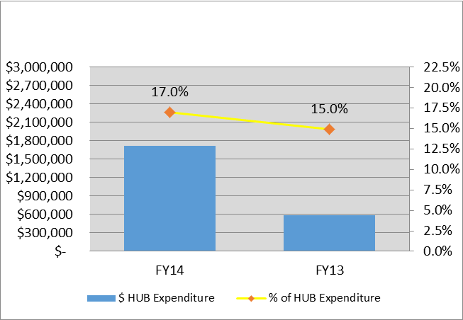
HUB Eligible Expenditures Comparison of FY13 to FY14
 | FY14 | FY13
Total HUB Operating Expenditure | $ 537,514 | $ 410,727
Total HUB CIP Expenditure | $ 1,178,719 | $ 173,795
Central Health’s total HUB Expenditure for 2014 is $1.7M compared to $585k in 2013. The increase is primarily due to the construction of the new Southeast Health and Wellness Center.

Slide 8
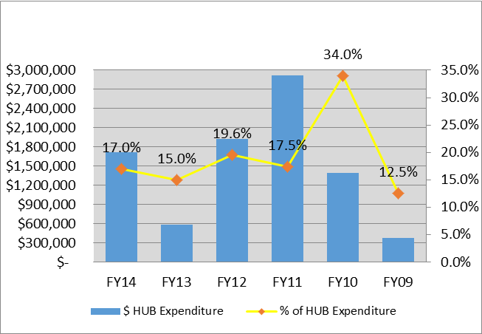
Eligible HUB Expenditures Historical Comparison

Slide 9
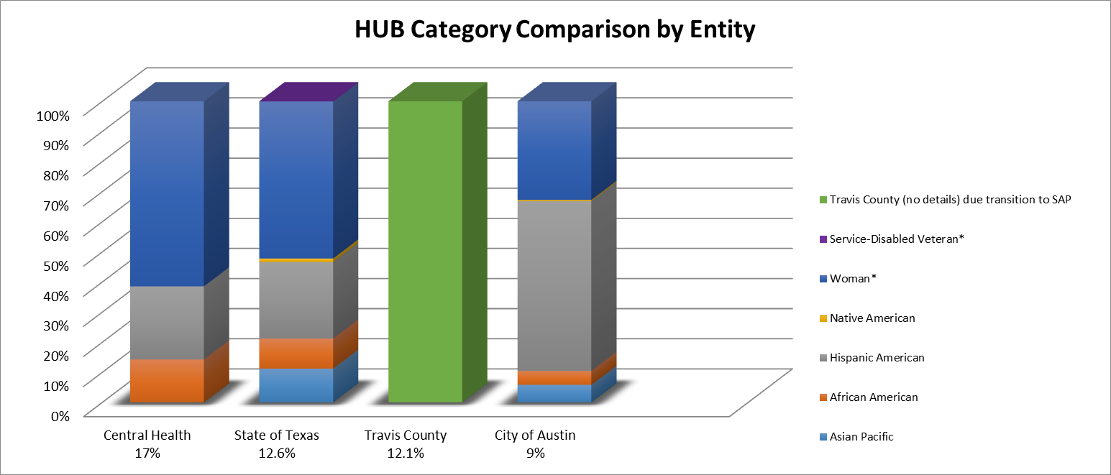
HUB Entity Comparison

Slide 10
Questions?

