Slide 1
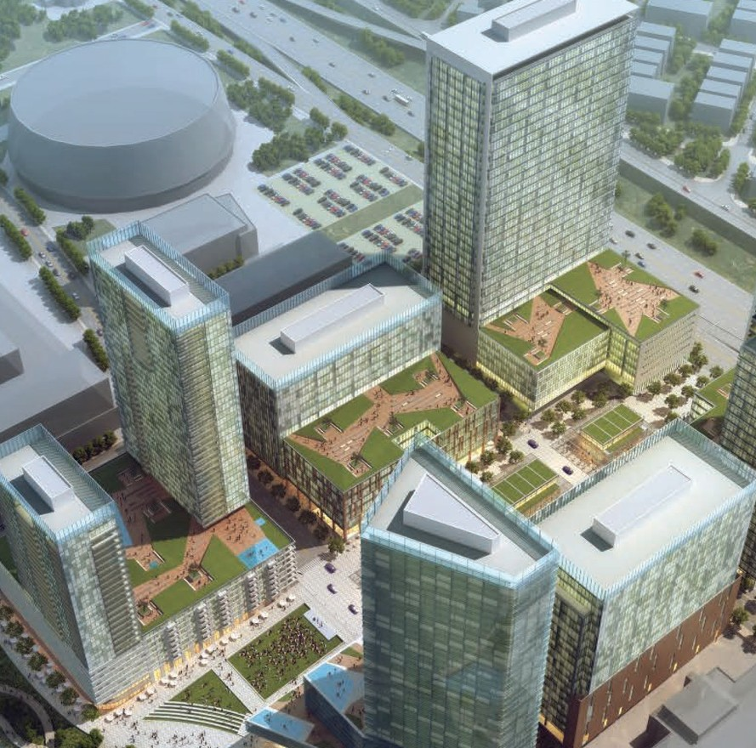
CENTRAL HEALTH BRACKENRIDGE CAMPUS REQUEST FOR QUALIFICATIONS
FOR DOWNTOWN AUSTIN REDEVELOPMENT
SEPTEMBER 1, 2016

Slide 2
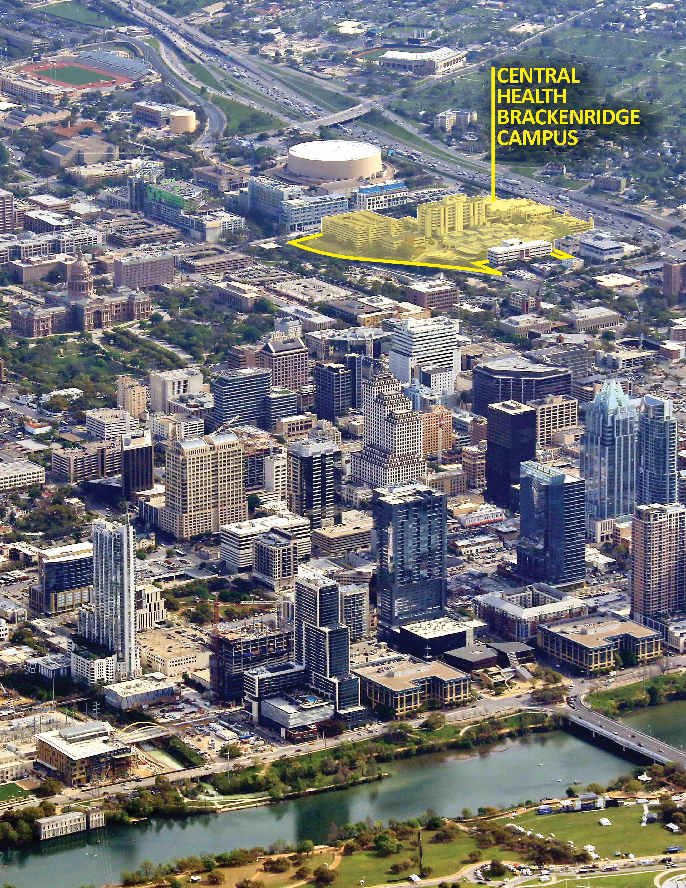

Slide 3
CENTRAL HEALTH BRACKENRIDGE CAMPUS REQUEST FOR QUALIFICATIONS NO. 1609-001 FOR DOWNTOWN AUSTIN REDEVELOPMENT
RF Q REPONSES DUE:
OCT OBER 21, 2016 2 p.m. Central Standard T ime ww w.centralhealth.net/purchasing/bid-sync/

Slide 4
II CENTRAL HEALTH BRACKENRIDGE CAMPUS RFQ

Slide 5

REQUEST FOR QUALIFICATIONS (RFQ)
Central Health Brackenridge Campus
Request for Qualifications (RFQ) No. 1609-001
For Downtown Austin Redevelopment
RFQ Issuance Date: Pre-Response Meeting:
Thursday, September 1, 2016
Thursday, September 15, 2016
9 a.m. – 1 p.m. (lunch will be served)
Location: Dell Medical School Health Learning Building, 5th Floor Board Room, 1501 Red River St., Austin, TX 78701 For maps, visit www.centralhealthcampus.net/planning.
Please RSVP no later than Tuesday, September 13, 2016, at 3 p.m. to purchasing@centralhealth.net
Friday, September 23, 2016
Friday, September 30, 2016
Friday, October 21, 2016, 2 p.m. Central Standard Time Purchasing Supervisor
purchasing@centralhealth.net
Interested firms are invited to submit responses in accordance with the instructions in this Request for Qualifications (RFQ) No. 1609-001.
Questions Due: Question Response Date: Response Due Date: RFQ Contact:
Response Comments:
(i) RFQ Summary
Central Health is seeking responses from prospective developers interested in a mixed-use development opportunity on a 14.3 acre multi-block site located between Red River Street and Interstate Highway 35 and between East 12th and East 15th streets in the northeast corner of Downtown Austin (the Site).
(ii) One original response submittal, 10 paper copies and one electronic copy (flash drive) must be delivered to the following location:
Central Health
Attn: Purchasing Supervisor
1111 E. Cesar Chavez St. Austin, TX 78702
Responses received at the designated location after the published time and date of
2 p.m. Central Standard Time, October 21, 2016 will not be considered.
SEPT EMBER 1, 2016 www.centralhealth.net/purchasing/bid-sync/ III

Slide 6
IV CENTRAL HEALTH BRACKENRIDGE CAMPUS RFQ

Slide 7
TABLE OF CONTENTS
DOWNTOWN AUSTIN DEVELOPMENT OPPORTUNITY
  Purpose of this Request for Qualifications (RFQ) ......................1
  Overview of the Site and its Master Plan................................2 C. About Central Health .................................................... 14
REQUEST FOR QUALIFICATIONS PROCESS AND REQUIREMENTS
A. Purchasing Supervisor .................................................... 17
B. Definition of Terminology................................................. 17
C. Sequence of Events ....................................................... 18
D. Explanation of Events..................................................... 19
E. Protest Deadline ........................................................... 20
F. General Requirements .................................................... 20
RESPONSE FORMAT AND ORGANIZATION
A. Number of Responses..................................................... 25
B. Number of Copies ......................................................... 25
C. Response Format - Mandatory ............................................ 25
CONTENTS FOR STATEMENT OF QUALIFICATIONS
A. Development Entity ...................................................... 27
B. Financial Qualifications .................................................. 27
C. Experience ................................................................. 28
D. Project Understanding and Approach .................................. 29
EVALUATION CRITERIA
A. Financial Qualifications .................................................. 31
B. Comparable Project Experience ........................................ 31
C. Project Understanding and Approach .................................. 31
D. Firm and Individual Team Member Experience ....................... 31 E. References ................................................................. 31 F. Interview ................................................................... 32 G. Step 2 RFP Process ........................................................ 32
ATTACHMENTS
A. Acknowledgment of Receipt Form...................................... 35
B. Conflict of Interest Questionnaire...................................... 37
C. Certificate of Secretary.................................................. 39
APPENDICES
  The Guiding Principles and Planning Parameters .................... 41
  Proposed Roadway and Open Space Exhibits ......................... 45
III.
VII.
SEPT EMBER 1, 2016 www.centralhealth.net/purchasing/bid-sync/ V

Slide 8
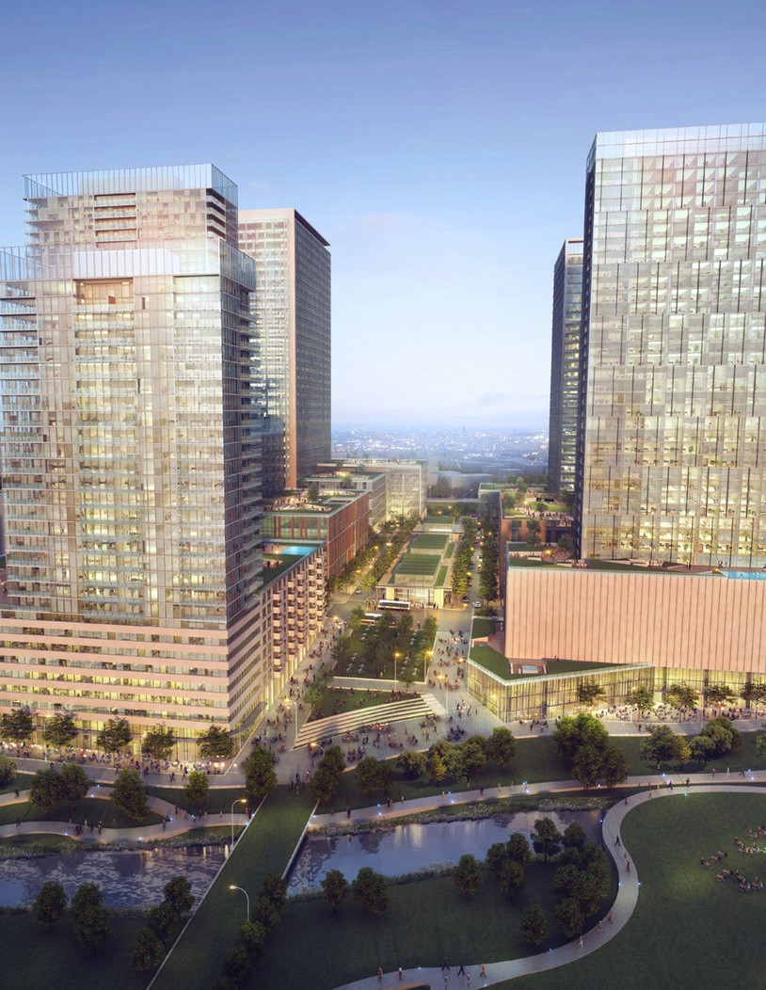
I. DOWNTOWN AUSTIN DEVELOPMENT
OPPORTUNITY

Slide 9
A. Purpose of this Request for Qualifications (RFQ)
Central Health is seeking responses from prospective developers interested in a mixed-use development opportunity on a multi-block site located between Red River Street and Interstate 35 and between 12th and 15th streets in the northeast corner of Downtown Austin (the Site). Central Health envisions this as a master developer opportunity, through which Central Health would partner with one or more entities to develop the multi-block property in a coordinated manner – including infrastructure and buildings.
The Site, known as the Central Health Brackenridge Campus (CHBC), is owned by Central Health, and has been occupied by medical buildings including University Medical Center Brackenridge hospital, Clinical Education Center, a medical office building, plus parking structures and other related support facilities. The hospital and some of the related support functions are being replaced by a new teaching hospital under construction—called the Dell Seton Medical Center at The University of Texas (Dell Seton)—immediately north of the Site, which will
be owned by Seton Healthcare Family and affiliated with the new Dell Medical School at The University of Texas at Austin. As a result of the hospital relocation, Central Health’s 14.3 acres will be made available for redevelopment.
Central Health has worked extensively with consultants, stakeholders and the community to prepare the Central Health Brackenridge Campus Master Plan (Master Plan) to inform
development opportunities on the Site. (See www. centralhealthcampus.net/planning/). The vision for this Site includes a high-density, mixed-use development oriented to pedestrian-friendly streets, a public market and public spaces connecting to Waterloo Park and the linear park improvements planned along Waller Creek Greenway. Uses on the Site may include housing, office, hotel, and retail space, as well as opportunities for additional health-related uses including technological innovation.
Central Health is a special purpose district governed by a Board of Managers, with a mission of providing access to and delivery of quality health care to eligible residents of Travis County. It is the intent of Central Health to retain ownership of the Site and lease it to the developer. In fiscal year 2016, Central Health will receive $34.4 million in lease revenues for facilities currently on the Site. Although lease revenue will be reduced during the Site development, Central Health intends to strongly consider responses that maximize future Site lease revenue.
This current Request for Qualifications (RFQ) is Step 1 of a two-step process. Following a review of initial qualifications submitted by interested
respondents, an Evaluation Committee will determine, based on those submittals and interviews with respondents, which respondents would be best suited to develop the Site to meet the objectives of Central Health and the community (shortlisted respondents).
In Step 2, Central Health will contact the shortlisted respondents, identified during the Step 1 evaluation process, and through a Request for Proposal (RFP) invite them to prepare a more detailed but still conceptual project proposal for review by the Evaluation Committee.
The respondent selected through the two-step process will enter into a period of exclusive negotiations with Central Health to refine the development program and finalize legal and business terms for a ground lease and other documents.
SEPT EMBER 1, 2016 www.centralhealth.net/purchasing/bid-sync/ 1

Slide 10
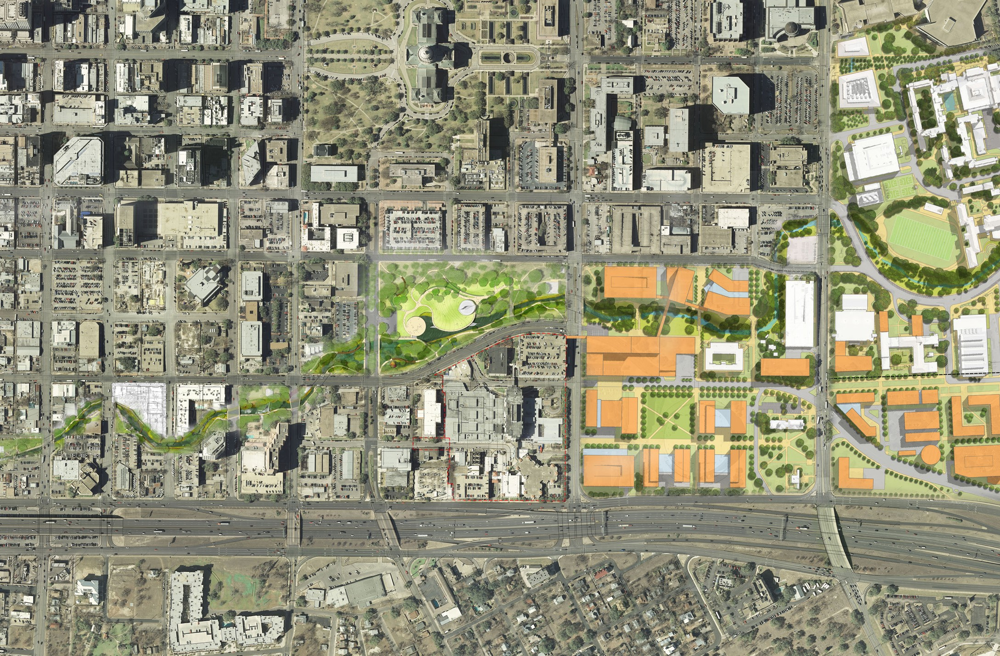


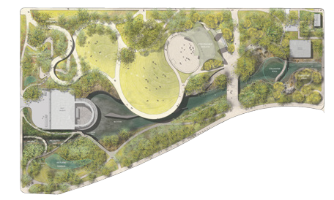
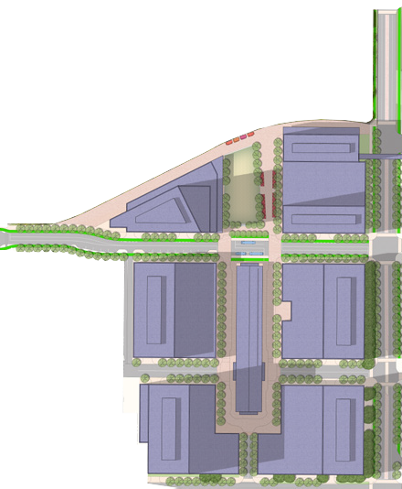




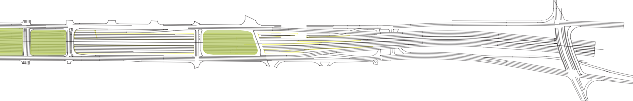


B. Overview of the Site and Its Master Plan
This section describes the Site and its context, as well as the vision and planning parameters established by Central Health for the future development.
hospital adjacent to the medical school. The medical school opened in July, and the teaching hospital is nearing completion.
When Dell Seton opens in May 2017, Seton will transfer hospital operations from the current facility at the Site to this new hospital. Seton’s move to
its new facilities opens a unique opportunity to redevelop Central Health’s 14.3-acre property and build a new, mixed-use community within Austin’s downtown, where people can live, work, learn, and play in an environment that encourages and supports innovation. By maintaining focus on the Master Plan’s three guiding principles of Mission, Stewardship and Partnership during the redevelopment of the Site, Central Health will realize a once-in-a-generation
1. Plans for The University of Texas Health District and Nearby Initiatives
The opportunity to redevelop the Central Health Brackenridge Campus is born out of transformative initiatives to the health care delivery system and its physical infrastructure in Travis County. Central Health’s successful 2012 tax ratification election resulted in a mandate from the voters of Travis County to support the creation of the Dell Medical School at The University of Texas (UT), and led Seton Healthcare Family (Seton) to build a new teaching
E 7th St
E 8th St
E 9th St
E 10th St
E 11th St
Texas State Capitol Complex
E 15th St
Martin Luther King Jr Blvd
Congress Ave
Congress Ave
Brazos St
Brazos St
San Jacinto Blvd
San Jacinto Blvd
University of Texas
Proposed Episcopal Church National Archives
Trinity St
Affordable Housing Project
Innovation Zone
Waterloo
Parking
MOB
Trinity St
Park
Waller Creek
Research Building
Waterloo
Neches St
Park
Parking
Proposed 10-Story Hotel
Waterloo Park Promenade
Waterloo Park Overlook
Teaching Hospital
Nursing School
Academic Building
Proposed Concert Venue Expansion
Red River St
Proposed Office and
Residential Tower
New Red River St
New Red River St
E 7th St
E 8th St
E 9th St
E 10th St
E 11th St
E 12th St
Health South
E 13th 1/2 St
E 14th St
E 15th St
Education and Administration Building
University of Texas Health District
Academic Academic Academic Academic Building Building Building Building
Texas Future Farmers of America Association
Central Plaza & Public Market
Sabine St
County Examiner
Texas Municipal Retirement System
AE
Substation
Parking
I-35 Frontage Rd
I-35 Improvement
Project
Central Health Brackenridge Campus
d
I-35 Frontage Rd
v
l
I-35
B
r
Proposed I-35 Cap
Proposed I-35 Cap
Proposed I-35 Cap
J
ng
Ki
r
e
h
t
Central East Austin Neighborhood
u
L
n
i
t
r
a
New Residential Project
Proposed Mixed-Use Residential Project
M
0 80 160 320
CENTRAL HEALTH BRACKENRIDGE CAMPUS: CONTEXT FOR THE FUTURE
The Site is located in the Northeast District of Downtown, in the center of many planned projects and initiatives.
2 CENTRAL HEALTH BRACKENRIDGE CAMPUS RFQ

Slide 11
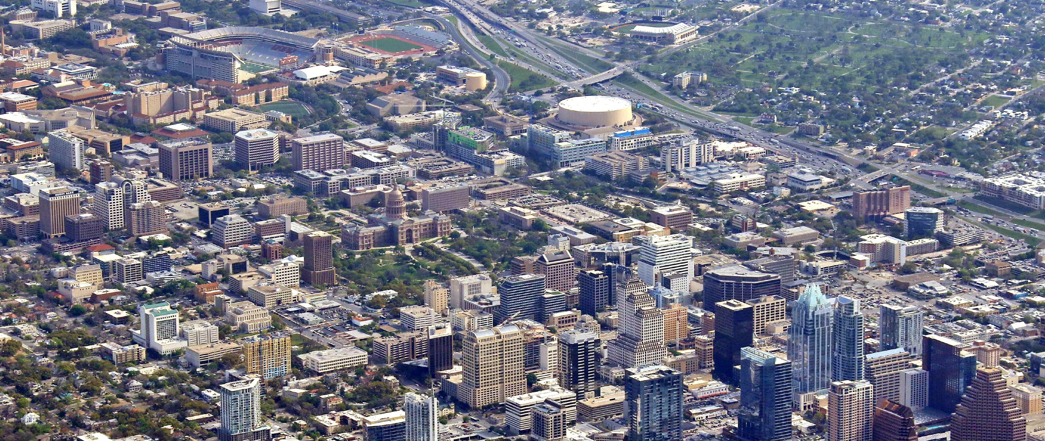














opportunity to transform and improve health care in Travis County - and do so in a way that supports its mission while promoting economic development throughout our community.
This opportunity is not isolated, however, as numerous initiatives are underway in the vicinity of the Site. In addition to the UT and Seton projects, these proximate initiatives include:
Capital Metro’s Project Connect, which envisions rapid bus and urban rail, as well as local bus service interfacing with other modes of transit that directly serve the Site and Waterloo Park.
The Texas Department of Transportation’s (TxDOT’s) planned improvements to the downtown segment of I-35, including depressing the freeway and “capping” it with surface-level parks and plazas, intended to better link East Austin to Downtown.
The efforts of the Texas Facilities Commission (TFC) to consolidate State of Texas offices within new buildings to be located along North Congress Avenue, which will be rebuilt as a greatly enhanced, mall-like promenade north of the Capitol Building.
The efforts of the Downtown Austin Alliance (DAA)
– with its $5 million public improvement district that includes the Central Health Brackenridge Campus – is a partnership of downtown property owners, individuals, and businesses devoted to advancing the collective vision for the future of
downtown.
The newly-completed Waller Creek Tunnel Project which removed more than 28 acres of downtown property along Waller Creek from the 100-year floodplain, allowing for these properties to be fully developed.
The Waller Creek Conservancy’s efforts to implement a series of parks, plazas, promenades and trails along Waller Creek, from Waterloo Park (adjacent to the Site) south to Lady Bird Lake.
The creation of a nonprofit organization, Capital City Innovation, Inc. by Central Health, UT and Seton to guide development of an “Innovation Zone” which will serve as a catalyst for collaboration and advancement of health-related research and commerce.
These initiatives signal the northeast quadrant of downtown Austin has a dynamic future, and the Site stands at the center of these many planned projects.
THE UNIVERSITY OF TEXAS HEALTH DISTRICT
CENTRAL HEALTH BRACKENRIDGE CAMPUS
IH 35
TEXAS STATE CAPITOL
DOWNTOWN AUSTIN
The Site is within walking distance of the UT campus and many of Downtown’s major attractions.
SEPT EMBER 1, 2016 www.centralhealth.net/purchasing/bid-sync/ 3

Slide 12
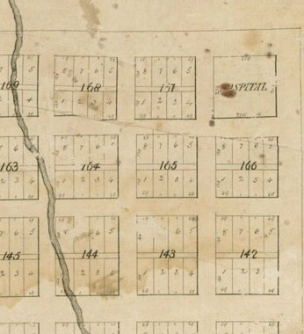
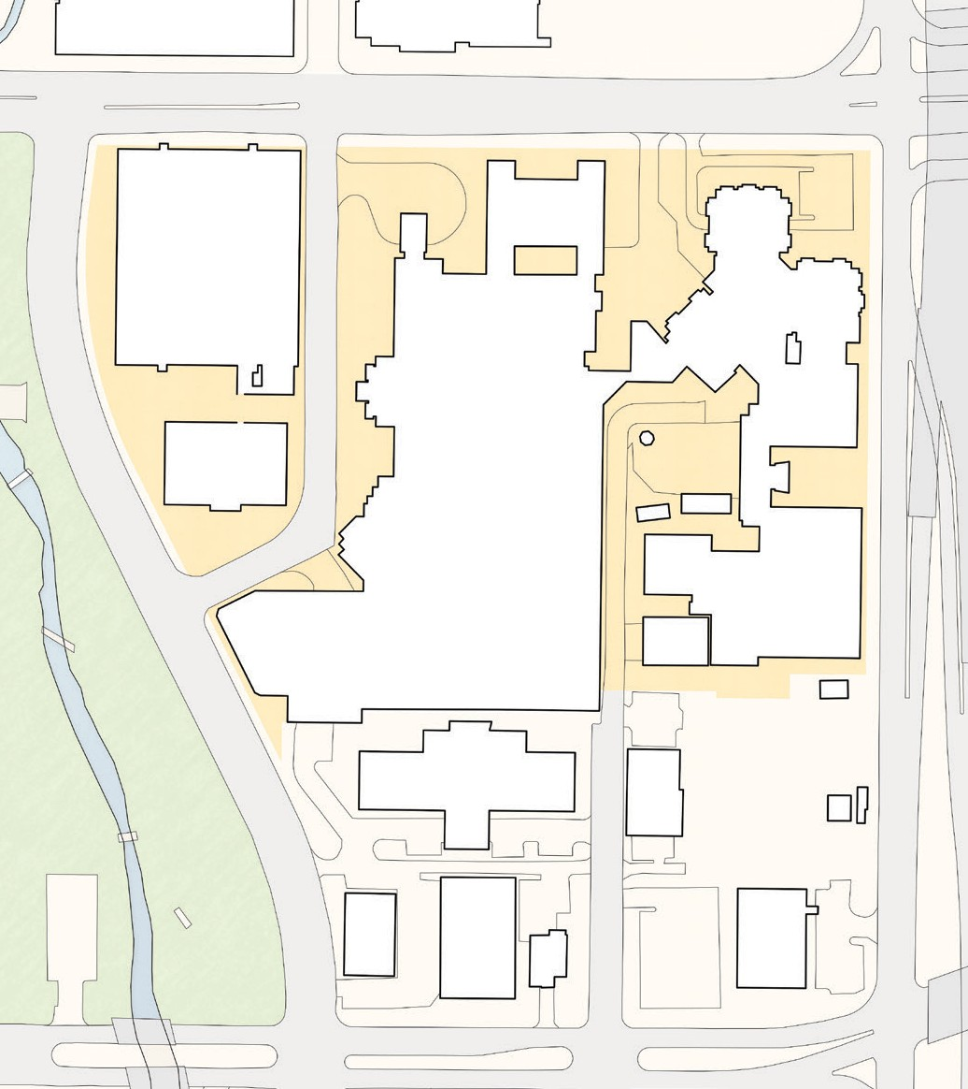




2. Master Planning Process
Over the past two years, Central Health has been actively engaged in developing the Master Plan for the Central Health Brackenridge Campus—which has been the site of Austin’s public hospital for over 100
years. This Master Plan, informed by significant public outreach and stakeholder input, lays out a broad vision for the future of the Site that is consistent with Central Health’s mission. The Master Plan sets forth 33 specific policies and actions (the Planning Parameters: see Appendix A) intended to guide the near-term and long-term reuse and redevelopment of the Site, which will begin when Seton transfers University Medical Center Brackenridge (UMCB) hospital operations
to the new Dell Seton hospital. Respondents should carefully review the adopted Master Plan, located at: http://www.centralhealthcampus.net/planning/
3. Introduction to the Property
Bounded by Red River Street on the west, East 15th Street on the north and the southbound I-35 frontage road on the east, the Central Health Brackenridge Campus is a large “superblock” within downtown Austin. Today, there are no public streets running through the Site, although the original City Plan of Austin laid out by Edwin Waller in 1839 (Waller Plan) envisioned this area with a grid of streets encompassing six square blocks, including a block reserved for a “Hospital.” The Waller Plan lays out a public street
grid of typically 80-foot-wide rights-of-way, which define blocks that are typically 276 feet by 276 feet, or approximately 1.75 acres.
Dell Seton Medical Center
Dell Medical School
College Ave
E 15TH STREET
BLOCK 168
MAIN GARAGE
BLOCK 167
I-35 SOUTHBOUND FRONTAGE ROAD
I-35
O G NAL HOS TAL BLOCK
CEC BUILDING
HOSPITAL NORTH WING
RI
I
PI
E 14th St
BLOCK 164
POB
HOSPITAL TOWER
Red River St
Sabine St
East Ave
BLOCK 165
RED RIVER STREET
HOSPITAL SOUTH WING
BLOCK 166
CEC GARAGE
E 13th St
Waterloo Park
HELIPAD
CENTRAL PLANT
SABINE STREET
E 12th St
0 60 120 feet
The original 1839 City of Austin plan designated Austin’s most northeasterly block for a public hospital (outlined in black), which is today part of the Central Health Brackenridge Campus (outlined in red).
E 12TH STREET
The above existing Central Health Brackenridge Campus
Site shows the original City of Austin block numbers.
4 CENTRAL HEALTH BRACKENRIDGE CAMPUS RFQ

Slide 13
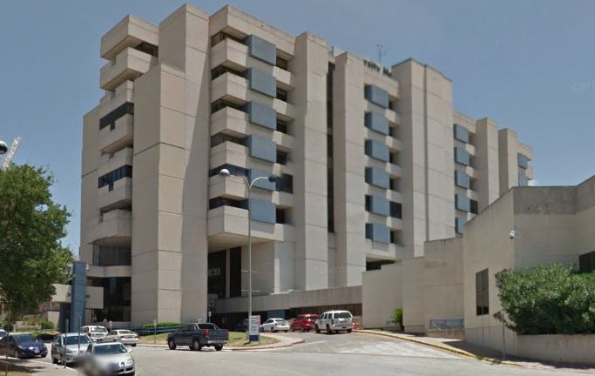
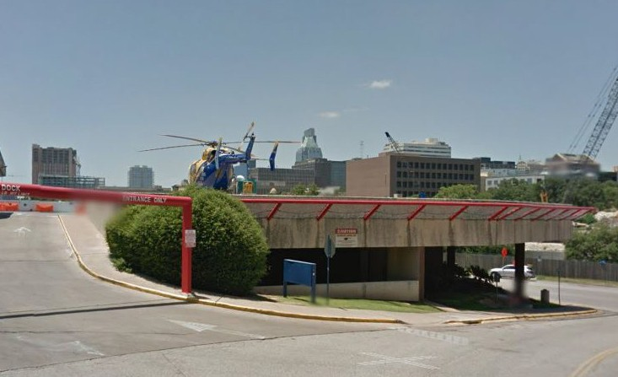
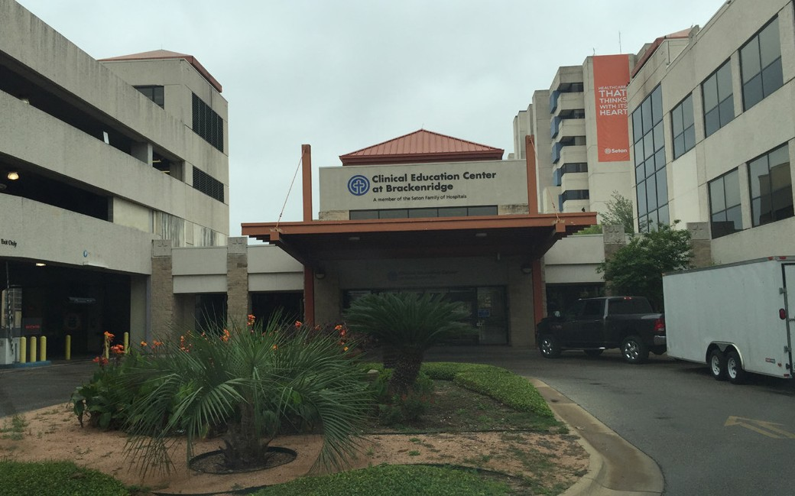
a. Current Uses
The complex of buildings on the Central Health Brackenridge Campus is organized around the UMCB Hospital Tower, which was constructed in phases from 1967 to 1974. The Hospital Tower occupies the southern part of Block 167 and is a nine-story tower flanked by two, two-story wings, providing 363 inpatient beds
and more than 530,000 square feet of floor area. The 200,000-square-foot Clinical Education Center (CEC) building east of the Hospital Tower was home to the Children’s Hospital until 2007, but is now used to train physicians and clinicians in the latest procedures using state-of-the-art equipment. The three-story Professional Office Building (POB) along Red River Street offers 43,000 square feet of office and clinical space. Two parking garages are located on the Site: the Main Parking Garage, a nine-level structure with approximately 1,431 spaces, adjacent to UMCB at Red River and 15th streets; and the CEC Parking Garage with approximately 300 spaces, just south of the CEC building. The Central
Plant building and underground infrastructure provide hot and chilled water for the heating and cooling of the Central Health Brackenridge Campus buildings.
The UMCB Hospital Tower is scheduled to be deconstructed by early 2018, along with its South Wing.
b. Phased Redevelopment
The Master Plan calls for the Hospital Tower, its South Wing, the POB and the Helipad to be deconstructed shortly after Seton completes vacating these buildings in mid-2017. The CEC, the Main Parking Garage, the
CEC Parking Garage and the North Wing of the Hospital (which serves as a recently developed Psychiatric Emergency Department) have potential for revenue- producing interim use in the short term. The Master Plan vision, however, is to ultimately deconstruct most of
the structures and redevelop their underlying land. As described below, the Master Plan envisions that the Main Parking Garage and the Central Plant would be retained for the foreseeable future to serve new and existing tenants on and around the Site.
The Professional Office Building (POB) and the Helipad (pictured) is scheduled to be deconstructed in early 2018.
The Clincial Education Center (CEC) will have a short-term lease, though the Master Plan calls for its eventual deconstruction.
SEPT EMBER 1, 2016 www.centralhealth.net/purchasing/bid-sync/ 5

Slide 14

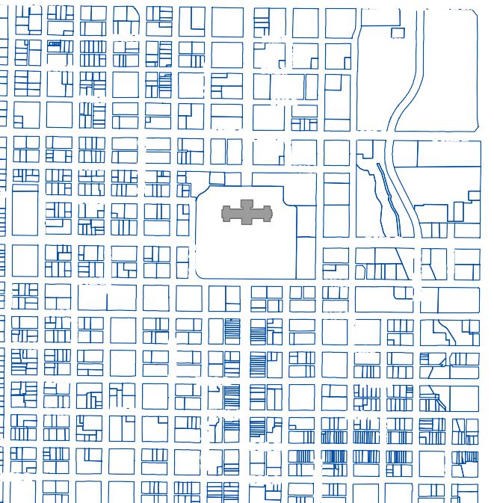
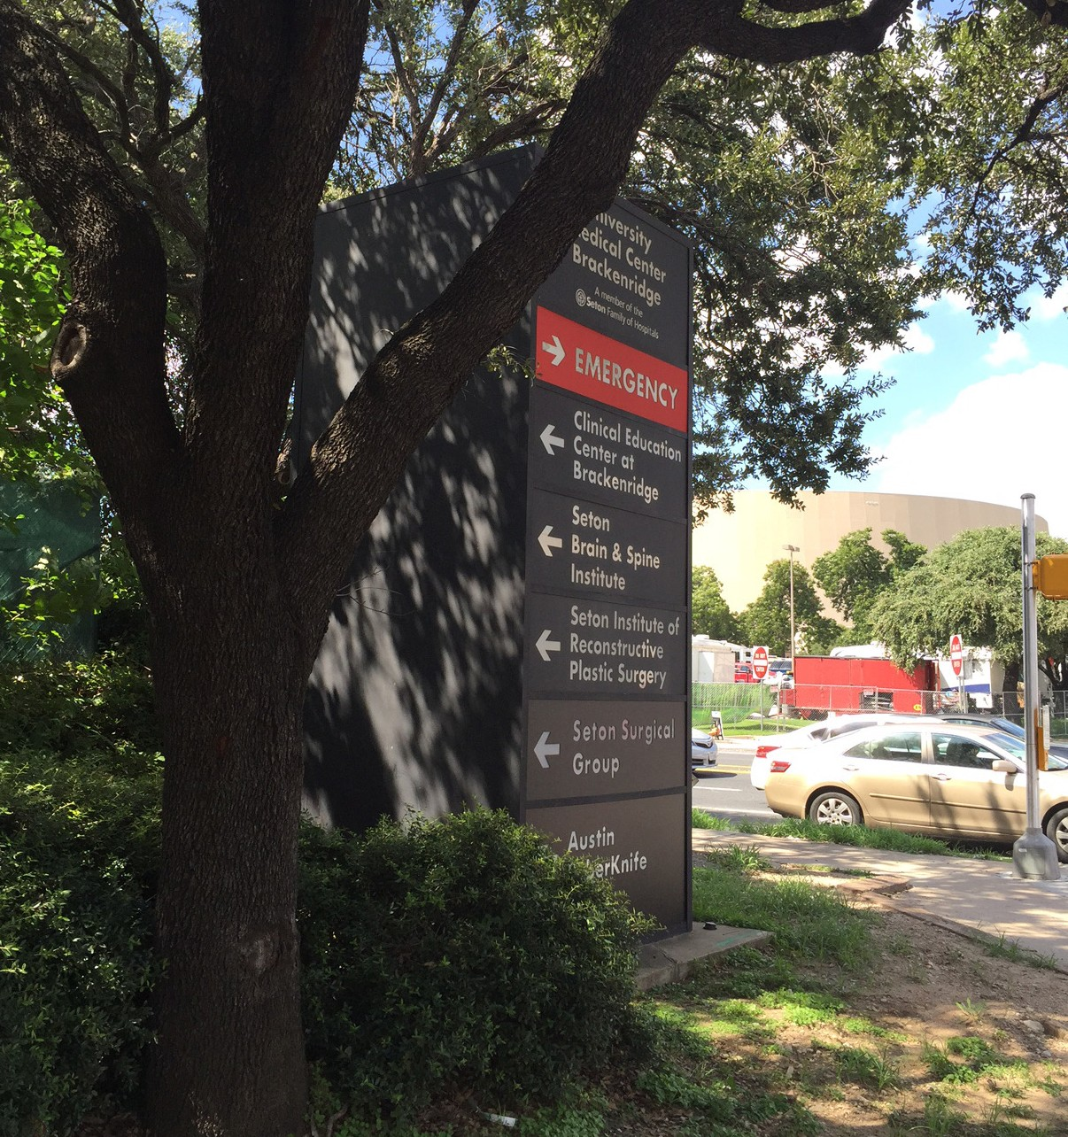


c. Zoning and Development Regulations
Presently, the Site is zoned as a “P” (Public) zoning district, allowing its use for governmental, civic, public service, or institutional purposes. Central Health is
a political subdivision of the State of Texas, and as such, has immunity from certain of the City’s zoning and land use regulations. However, in most cases, Central Health will require the developer to comply with applicable Austin land development regulations, including zoning, notwithstanding Central Health’s ownership of the Site. Zoning considerations will be addressed by Central Health and the City of Austin prior to the selection of a master developer. Central Health is currently in discussions with the City of Austin regarding uses on the site, including health care, office, residential, research labs, hotel, retail, entertainment, and other uses; and regarding density and building heights, street and open space locations, building design standards, and minimum green building-requirements.
d. Capitol View Corridors
The Site is relatively unique in Downtown Austin in that the Capitol View Corridor Ordinance – which restricts heights on many downtown parcels so
that the dome of the State Capitol building can be viewed from various locations – affects only a very small corner of Block 168 of the Site, limiting it to 125 in height. As such, the Site, representing six full city blocks, offers greater potential than any other developable part of the Downtown.
e. Heritage Tree Ordinance
The City of Austin’s Heritage Tree Ordinance requires efforts to preserve certain species of mature trees. With few trees on the interior of the Site, this ordinance is not expected to affect development significantly. However, some trees on the north, east and west edges of the Site may qualify for protection, and these trees may limit the footprint of new buildings.
er King Jr Blvd
E Martin Luther
King
W 18th St
E 18th St
E 18th St
W 17th St
St
Congress Ave
Brazos St
Colorado
E 17th St
W 16th St
15th
E 16th St
15th S
E 15th St
SITE
W
S
15th S
t
E
t
E
t
pe St
Brazos St
u
W 14th St _{a}
l
d
a u
St t ^{G}
S
e W 13th St
d
n
a
r G
o
i R
t S
o
i
n
o
t
n
A
e W 11th St_{n}
v a
A S
t
s
e W
W 10th St
t S
s
e
c
e u
W 9th St ^{N}
W 8th St
W 7th St W 7th St
t
W 5th St
E 14th St
Legend
Capitol Building Downtown Parcels
CVC - Ground Elevation
<VALUE>
Colorado St
E 12th St
Red River St
Sabine St
-25' - 0'
0' - 25'
25' - 50'
50' - 75'
75' - 100'
100' - 125'
125' - 150'
150' - 175'
175' - 200'
200' - 225'
225' - 250'
250' - 10,000'
E 11th St
E 10th St
Lavaca St
Trinity St
W 8th St
E 9th St
N IH 35 SB
E 8th St
Colorado St
W 7th St
E 7th St
Neches St
E 6th St
o Blvd
Sabine St
E 5th St
t
n
i c
Only a small portion of the Site is restricted in height to approximately 125 feet, to preserve a view to the State Capitol Building.
Mature trees along the periphery of the Site may be preserved.
6 CENTRAL HEALTH BRACKENRIDGE CAMPUS RFQ

Slide 15
4. Guiding Principles
The Master Plan is informed by three overarching, guiding principles developed and adopted by Central Health’s Board of Managers at the outset of the master planning process. These principles have been used
to evaluate different scenarios for developing the Site that could feature medical uses, housing, office, recreation, retail, etc. The guiding principles are:
The Master Plan calls for a 10-foot setback along the north edges of Block 167 and the Original Hospital Block, as well as along the I-35 southbound Frontage Road to allow for the preservation of these existing, mature trees. Central Health will work with the City of Austin to establish an agreement defining the tree preservation and mitigation plan for the Site.
f. Reduced Parking Requirements
The City of Austin’s Parking Ordinance encourages reduced and shared parking for mixed-use projects and for affordable housing units. The adopted Master Plan development scenario does not necessarily minimize the number of parking spaces required for the development as envisioned, but Central Health encourages respondents to explore such approaches, while also ensuring the development is functional and marketable.
Respondents are encouraged to be knowledgeable about the Downtown Austin Parking Strategy project (www.downtownaustin.com/daa/parking-strategy), a study recently launched by the Downtown Austin Alliance (DAA) to recommend and implement best practices in regulating and managing on-street and off-street parking.
M
MISSION: Advance Central Health’s efforts to provide access to health care to those who need it most, and promote Travis County as a model healthy community.
S
STEWARDSHIP: Promote uses and programs at the Central Health
Brackenridge Campus that support the short-and long-term fiscal stability of Central Health and deliver returns for the citizens and taxpayers of Travis County.
P
PARTNERSHIP: Strengthen and expand relationships with health and wellness providers, collaborate with other public- sector entities, and help advance the goals of the larger community.
g. Downtown Austin Alliance (DAA)
The Site falls within the perimeter of the Downtown Austin Alliance (DAA), a public improvement district. The DAA is a partnership of downtown property owners, individuals, and businesses devoted to preserving and enhancing the value and vitality of downtown Austin. It levees an annual tax and uses the proceeds thereof to advance the collective vision for the future of downtown.
These principles have been used to formulate the
33 planning parameters listed in the adopted Master Plan. These planning parameters are included in Appendix A: The Guiding Principles and Planning Parameters.
SEPT EMBER 1, 2016 www.centralhealth.net/purchasing/bid-sync/ 7

Slide 16








Expected Project Components
  High Density, Mixed-Use Development
The Master Plan envisions the development of roughly
3.7 million square feet or more of property on the Site. This development should contain a variety of uses, including but not limited to: residential, office, hotel, and retail, plus possible health-related uses as discussed below. The Illustrative Plan within the Master Plan provides an example of such a mix of uses, but is not intended to specifically prescribe the locations or amounts of each use. The massing (height and bulk) shown in the Master Plan is still illustrative, but reflects the desire to create a central open space with a public market building, flanked by lower building masses in the Site’s interior and taller building masses toward the Site’s edges. The
public market building and accompanying open space connecting to Waterloo Park are a part of the public community benefit package that this redevelopment will deliver to our community.
0 60 120 240 feet
b. Roadway and Open Space Infrastructure
Presently, there are only private drives and service roads within the 14.3-acre Site. The Master Plan envisions the historic street grid will be restored, including Red River Street and Sabine Street (north- south) through the Site as well as a new East 13th ½ and 14th Street, one-way couplet that will generally align with East 14th Street, immediately west of Waterloo Park. Pedestrians, bicyclists and occasional service vehicles will be able to access and traverse Waterloo Park along the old 14th Street right-of-way, crossing Waller Creek on the historic 14th Street Bridge in Waterloo Park. The existing alignment of Red River Street along the western edge of the Site will be vacated by the City of Austin and the western half of this right of way will become a major pedestrian and bicycle pathway, the Waterloo Park Promenade.
The eastern half will be made available for Central Health’s development on Blocks 164 and 168, as well as Central Health’s new open space block, the Waterloo Park Overlook. The new Red River Street would be constructed per the general location in the 1839 Waller Plan, and it would be aligned with the newly-constructed Red River Street segment north of East 15th Street. The Master Plan calls for these new streets to be designed as multi-modal Complete Streets (www.austintexas.gov/complete-streets) incorporating green infrastructure or low-impact development techniques, such as rain gardens.
The new street system will link Waterloo Park, the Waterloo Promenade, the Waterloo Park Overlook, and the Public Market Building. Although ideas to alter
the system may be entertained, respondents should consider this proposed street and open space system as relatively fixed, since it has been vetted by both the City of Austin and Capital Metro. (See Appendix B: Proposed Roadway and Open Space Exhibits, which includes cross-section designs of each roadway and open space.)
EAST 15TH ST
BLOCK 168
BLOCK 167
SABINE ST
ORIGINAL HOSPITAL BLOCK
14TH ST BRIDGE
OPEN SPACE BLOCK #1
NEW RED RIVER ST
EAST 14TH ST
2
OPEN
OPEN SPACE BLOCK #2 (PUBLIC MARKET & CENTRAL PLAZA)
E 14TH ST
I-35 SOUTHBOUND FRONTAGE ROAD
SPACE
EAST 13TH 1/2 ST
BLOCK #3
BLOCK 164
SABINE ST
BLOCK 165
BLOCK 166
WATERLOO PARK
1
Health South
Medical
AE
Substation
Examiner
Intake
Structure
SABINE ST
LEGEND
Existing Central Health Property Boundary (Approx. 14.3 Acres)
NOTES
This plan assumes that Red River Street will be relocated as
¹ illustrated here, and that the existing Red River ROW
Central Health Property to be Dedicated to COA for Public Streets (Approx. 4.1 Acres)
Central Health Property in Open Space (Approx. 2.8 Acres)
(approx. 1.52 acres) will be conveyed to Central Health.
₂ This segment of East 14th Street will be dedicated to the
City of Austin upon the future deconstruction of the Clinical Education Center Building (CEC).
Proposed Property and Public Right-of-Way Dispositions
8 CENTRAL HEALTH BRACKENRIDGE CAMPUS RFQ

Slide 17
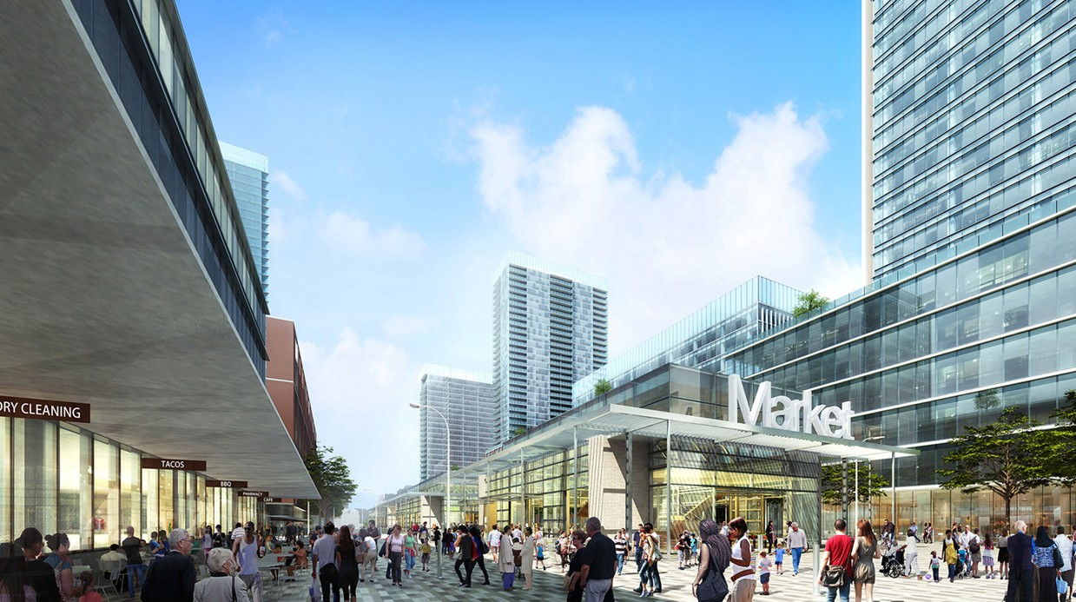
At this time, Central Health is evaluating several options for designing, funding and implementing the infrastructure. These roadway and open space options may include Central Health leading these efforts, the master developer leading, or some shared responsibilities to balance costs and risks. Central Health is also exploring the potential for external sources to fund some of these improvements. At
this point in time and to ensure comparability among responses, Central Health is asking that all respondents assume the master developer will be responsible for all infrastructure design, funding, and construction. However, this may be a point of significant partnering as a development agreement is negotiated in the future. Central Health expects to provide updated information regarding the infrastructure financing plan and appropriate
assumptions during Step 2 of this solicitation process.
c. Public Market
The Master Plan envisions the development and operation of a Public Market on the Central Plaza of the Site. This proposed market concept has been embraced by the Central Health Board of Managers as a place-making feature, an amenity for the future tenants of the Site, an economic opportunity for the community - and most importantly - as a means
of promoting health and wellness, consistent with Central Health’s overall mission. Central Health has commissioned a separate study with Project for Public Spaces (www.pps.org) to explore the design,
programming, financing, and operation of the Public Market, and that study is expected to be substantially complete by the end of 2016. It is anticipated the Public Market would include a permanent structure with vendor spaces for foods, products, and services provided primarily by local entrepreneurs. The Public
The proposed Public Market will be located on the Central Plaza.
SEPT EMBER 1, 2016 www.centralhealth.net/purchasing/bid-sync/ 9

Slide 18
Market would likely be governed by a non-profit organization. Central Health is also exploring the potential to incorporate their own administrative office functions in the upper floor(s) of the Public Market building. It is expected respondents will offer their own ideas for the Public Market as well, but that plans proposed by respondents should incorporate this concept in a meaningful way. Central Health expects to provide updated information regarding the Public Market Concept Plan and appropriate assumptions during Step 2 of the solicitation process.
e. Affordable Housing Context
Among Austin’s top list of livability issues is that of affordability. Austin has evolved into a city where the median family income cannot afford to purchase the median-priced house. One of the Central Health Board of Managers-adopted Planning Parameters in the Master Plan states the following:
“S-2.4: Through partnerships with affordable housing providers the development community and other stakeholders, consider a range of housing types in and around the proposed Innovation Zone, UT and/or the Brackenridge Campus.”
While Central Health’s mission is to provide access to high-quality and affordable health care, and while its revenue must be directed to achieving this mission, the selected master developer will be encouraged
to propose innovative concepts for addressing the
community’s affordability objectives.
d. Health-Related Uses
Block 167 lies directly across East 15th Street from the new Dell Seton Medical Center and the Dell Medical School at The University of Texas at Austin. This location makes Block 167 a strong candidate for health care-related uses that can capitalize on the proximity to the new facilities. Concepts explored to date have included non-hospital clinics, offices, incubator offices, and/or laboratories related to cancer, neurosciences, or other specialties that would complement the services to be provided in the emerging Medical District. The University of Texas (UT) has expressed preliminary interest in developing Block 167, or a portion of it, for health-related uses, but Central Health has not yet committed to offering the site to UT. It is anticipated Central Health, UT, and the selected master developer will continue to discuss the future of Block 167 for health-related uses, as well as an appropriate deal structure to optimize Central Health’s property value and revenue generation while complementing the overall Master Plan vision. Central Health reserves the right to develop this block working solely with UT or an end user, without any involvement of the selected master developer.
f. Living Wage
Central Health encourages respondents to pay all workers employed in connection with the
redevelopment of the Site no less than the living wages as established by the City of Austin at the time of the contract award, even if the living wage exceeds the wages set forth in the federal minimum wage scale.
g. Transportation Context
Another of Austin’s challenges has been providing mobility and access to keep pace with the significant growth that has occurred over the past 20 years.
Transportation to, and ease of parking within Downtown have been cited again and again as key factors threatening Downtown’s success as a place that can continue to be attractive, affordable and accessible for employees, residents and visitors.
10 CENTRAL HEALTH BRACKENRIDGE CAMPUS RFQ

Slide 19
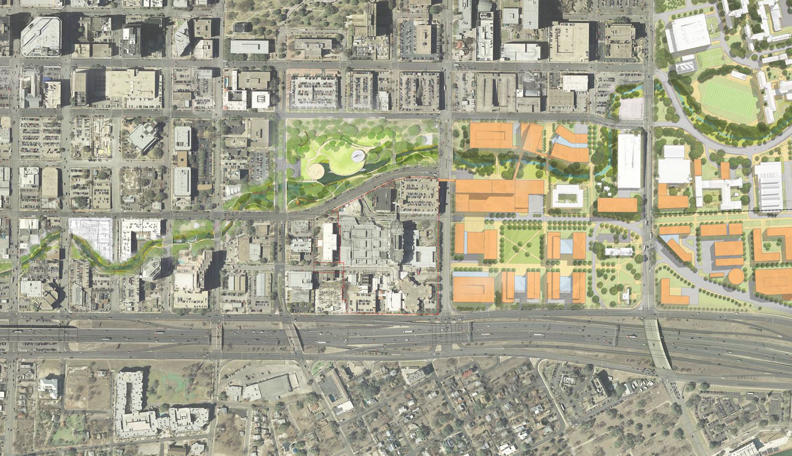

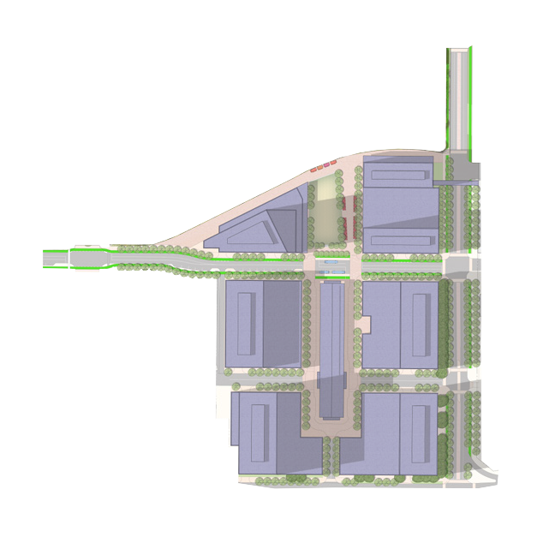
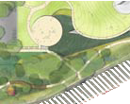






































































The Master Plan calls for the historic street grid to be restored, with tree-lined, multi-modal Complete Streets, creating a walkable and bike- able new neighborhood that connects seamlessly with adjacent areas.
While the Site is already well-served by Capital Metro buses, the Master Plan calls for a new bus plaza to be located at the heart of the Site: at the intersection of Red River Street and East 13th 1/2 and 14th streets.
The Texas Department of Transportation (TxDOT) and the City of Austin continue to explore the potential of depressing and capping the I-35 freeway as it passes south of the Central Health site and into downtown Austin, thereby removing a significant barrier to East Austin.
The Austin City Council recently approved a list of projects and initiatives to be included in a
$720 million transportation bond to be considered by voters in November 2016. These include multi- modal, Complete Streets improvements on four key transit corridors, as well as major roadway, bicycle and pedestrian improvements throughout Austin.
h. Parking Context
Parking at the Site must meet the needs of employees, residents and visitors. Parking for on-site uses should be provided in a manner that meets demand and
the City’s minimum parking requirements - taking into consideration reduced parking requirements for projects that meet the City’s affordable housing criteria and the reduced residential parking requirements that
T T T ^{T T}
STREE STREE STREE ^{STREE STREE} _{ARD}
7TH 8TH 9TH _{10TH 11TH} ^{V}
BRAZOS STREET
15TH STREET
MLK JR. BOULE
12TH STREET
The University of Texas
SAN JACINTO BOULEVARD
TRINITY STREET
Waterloo Park
NECHES STREET
168
RED RIVER STREET
164
RED RIVER STREET (PROPOSED)
165 167
SABINE STREET
The University of Texas
166
Health District
Proposed
I-35 Improvement
Central Health Brackenridge Campus
Proposed High Capacity Transit Line
Project
/
/
/
Proposed/Existing Bus Route
Proposed/Existing Bicycle Facility Proposed/Existing Hike & Bike Trail Parks/Open Space
Central East Austin Neighborhood
0 320 feet
Transportation Context Map of the Brackenridge Campus
0 80 160 320
SEPT EMBER 1, 2016 www.centralhealth.net/purchasing/bid-sync/ 11

Slide 20
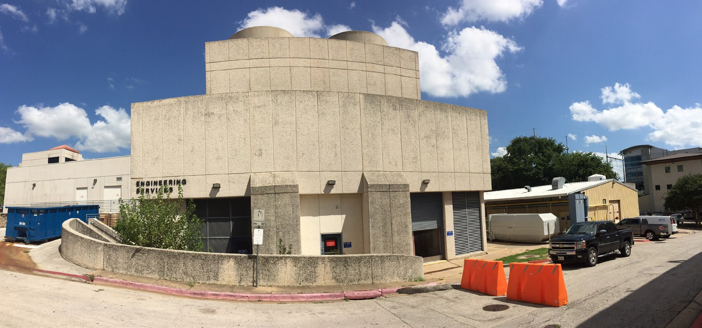
would be available to the project through the Shared Parking Ordinance option. Respondents should consider parking provisions in the manner they find most suitable and efficient, including underground, and encapsulated structured or podium-style facilities. Surface parking, however, is not allowed in Downtown, except possibly as a short-term, interim condition. A consolidated underground garage stretching below the new street grid may be possible, though the cost and engineering implications of such a configuration have not yet been explored.
In addition, Central Health has agreed to lease a substantial number of existing parking spaces on the Site to Seton for use by employees and patients at the new Dell Seton hospital, per state hospital licensure requirements. Currently, Seton leases and operates the entire Main Parking Garage, including all parking spaces and a small amount of office space. A new pedestrian bridge linking Dell Seton to the existing
Main Parking Garage is under construction across 15th Street to increase the safety and convenience of this parking facility.
The Master Plan assumes Seton’s parking requirements will continue to be met by retaining and leasing the existing Main Garage on Block 168 for the foreseeable future, but in the Step 2 RFP process, respondents may propose alternative solutions, such as overbuilding parking elsewhere on the Site - if such an arrangement can improve the design and value generation of the overall development and still provide convenient parking to the new hospital. It is assumed the selected master developer would not be a direct party to the parking lease agreement between Central Health and Seton, unless and until the Seton parking is provided anywhere other than Block 168.
i. Central Plant
The Central Plant currently provides heating, cooling and medical gases to UMCB as well as to the Health South Rehabilitation Hospital located directly south of the Site. It is expected to continue providing heating and cooling services to the CEC and the North Wing of the UMCB complex during the time those buildings continue to be in use by Seton. The long-term plan for the Central Plant is to expand its capacity to provide chilled water for the entire redeveloped site.
The capacity of the Central Plant will need to be increased as the Site redevelops.
12 CENTRAL HEALTH BRACKENRIDGE CAMPUS RFQ

Slide 21
6. Expected Roles
The development of the Site is expected to involve numerous parties, each taking different roles and responsibilities. A partial list and preliminary description of such roles is provided below:
The University of Texas at Austin has expressed interest in developing and/or occupying new buildings within the Site and has already expressed interest in exploring such concepts for Block 167, directly across 15th Street from the new Dell Seton hospital and the Dell Medical School Health Learning Building, as discussed in Section I, B.5d.
Seton Healthcare Family currently leases the entire Site and intends to continue to be a major tenant on the Site. Central Health is completing the process of restructuring the current lease into new separate leases: 1) a long term lease of the Main Parking Garage and 2) short term leases of the CEC Building and the CEC Parking Garage and the North Wing of UMCB (the Psychiatric Emergency Department).
The City of Austin and Central Health are discussing an inter-local agreement that will define building design parameters, roadway design, the availability of chilled water to the Site, the future ownership and maintenance of the current Red River Street right of way, parking management, transit facilities, open space and parks within the Site, the level of financial participation that the City may contribute to the completion of roadway and utility infrastructure, and other issues. The goal of Central Health and the City in discussing an inter-local agreement is to resolve as many major infrastructure and regulatory hurdles as possible before a master developer is selected.
Central Health will serve as the ground lessor, providing within its capabilities low-cost financing for certain project components such as selected infrastructure, and assisting in attracting and providing support for health-related uses. Central Health may hold certain parcels until an appropriate time for master developer takedown based on market, financing, and phasing considerations.
The master developer will coordinate the design, marketing, financing, construction, and operation of infrastructure and development projects on the Site. This may include buildings the master developer will retain for its own portfolio, and others for which the master developer will secure a third party owner and/or operator. Note that
while it is anticipated the master developer would secure rights to develop all six of the Master Plan- defined blocks of the Site, Central Health reserves the right to identify land or uses for separate negotiation and disposition that is consistent with the Master Plan and Central Health’s mission.
An example may be if a health-related user approaches Central Health for an opportunity prior to completion of negotiations with the selected master developer.
SEPT EMBER 1, 2016 www.centralhealth.net/purchasing/bid-sync/ 13

Slide 22
C. About Central Health
This section provides background on Central Health and its affiliates, which may be helpful to the respondent in preparing the response. The information is provided as an overview and is not intended to be a complete and exhaustive description. Please also review Central Health’s website: www.centralhealth.net
MAP is a long-time benefit provided by Central Health and previously the City of Austin and Travis County. The program provides basic health care coverage, including a medical home, for low-income residents of Travis County—most of whom earn below 100 percent of the Federal Poverty Level—and are ineligible for other government health care assistance. Seton provides acute care and some specialty care for MAP enrollees, while other safety net providers—including Federally Qualified Health Centers (FQHCs)—provide primary care.
Through the charity care and sliding-fee scale programs, health care services are also provided by Seton to Travis County residents who are not MAP- eligible but are either financially or medically in need of assistance. FQHC primary care providers, such as CommUnityCare, El Buen Samaritano, Lone Star Circle of Care and People’s Community Clinic, also provide services funded by Central Health.
1. Goals and Objectives
Central Health’s mission is to improve the health of Travis County residents by caring for those who need it most—with a focus on serving the low-income and uninsured populations. This mission emphasizes improving the quality of health care and outcomes, rather than focusing on increasing the volume of services. As a special purpose district, Central Health relies on public funding to work toward its vision of transforming Travis County into a worldwide model of health. However, Central Health realizes it cannot achieve this work alone, which is why it partners with and enlists the assistance of local hospitals, nonprofits, educational institutions and the community at large.
3. Creation of Central Health
In 2004, Travis County voters approved the creation of Central Health as a hospital district under Chapter 281 of the Texas Health and Safety Code. Central Health is governed by a nine-member volunteer Board of Managers, of which four members are appointed by the Austin City Council; four members are appointed by the Travis County Commissioners Court; and one member is jointly appointed by both entities.
Central Health is a separate political subdivision of the State of Texas whose geographic boundaries are contiguous with those of Travis County. Central Health is a special purpose taxing entity which levies property taxes to fund health care and health education.
2. History of Safety-Net Health Care Delivery in Travis County
Until 1995, the City of Austin owned and operated Travis County’s public hospital, Brackenridge Hospital (now known as UMCB) and provided funding for operations. In 1995, the City of Austin transferred the license to operate UMCB and the local children’s hospital to Seton in exchange for Seton’s agreement to provide the majority of the inpatient hospital care for the safety net population of Travis County. Seton also agreed to provide acute care and some specialty care services to residents enrolled in the local Medical Access Program (MAP) and to charity care patients in Travis County.
14 CENTRAL HEALTH BRACKENRIDGE CAMPUS RFQ

Slide 23
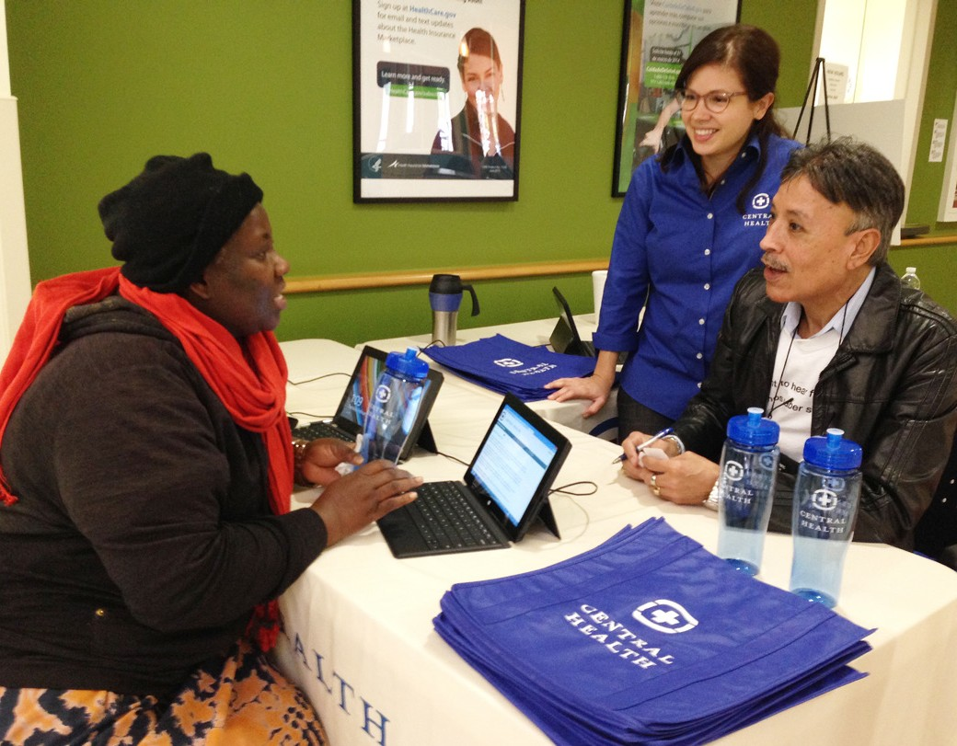
Central Health is organized and operated as a payer of health care services and does not provide direct patient care. Rather, it contracts with a network of health care providers, primarily through the Community Care Collaborative, a non-profit organization formed in partnership with Seton.
As prescribed by its governing legislation, Central Health inherited a portion of the tax rates formerly levied by the City of Austin and Travis County. Property taxes remain the primary source of revenue for Central Health, accounting for approximately 80 percent of its total revenue. Upon its creation, title to the Central Health Brackenridge Campus and the accompanying Seton lease were also assigned to Central Health. These lease payments support Central Health’s funding for health care services provided to Travis County’s increasing safety-net population and are the second largest source of income for Central Health.
Local public funding and matching federal Medicaid dollars serve as the funding sources for the Waiver program. The tax referendum and the Waiver provide Central Health and Seton the opportunity to transform and make significant enhancements to the health care safety net, including:
A new teaching hospital, Dell Seton, to replace the aging UMCB;
A medical school on The University of Texas at Austin campus (the Dell Medical School at The University of Texas at Austin);
Improved and expanded specialty care services; and
An infrastructure to create an integrated delivery system.
As Central Health moves forward with the
redevelopment of the Central Health Brackenridge
Campus, it is committed to honoring residents’ support
4. Improving the Future of Local Health Care
In 2011, Texas received approval from the Centers for Medicare and Medicaid Services (CMS) to operate the Texas Healthcare Transformation and Quality Improvement Program through a waiver of Section 1115 of the Social Security Act (the Waiver). In 2012 Central Health asked Travis County voters for an increased tax rate to provide adequate local matching funds for the Waiver. Following a successful referendum, Central Health increased its tax rate in fiscal year 2014 by five cents (63 percent) to 12.9 cents per $100 of assessed property value. This commitment of additional tax dollars demonstrates residents’ commitment to support the mission and work of Central Health.
by creating spaces that will serve Travis County residents' health and wellness needs.
Central Health partners with and enlists the assistance of local hospitals, nonprofits, educational institutions and the community at large.
SEPT EMBER 1, 2016 www.centralhealth.net/purchasing/bid-sync/ 15

Slide 24
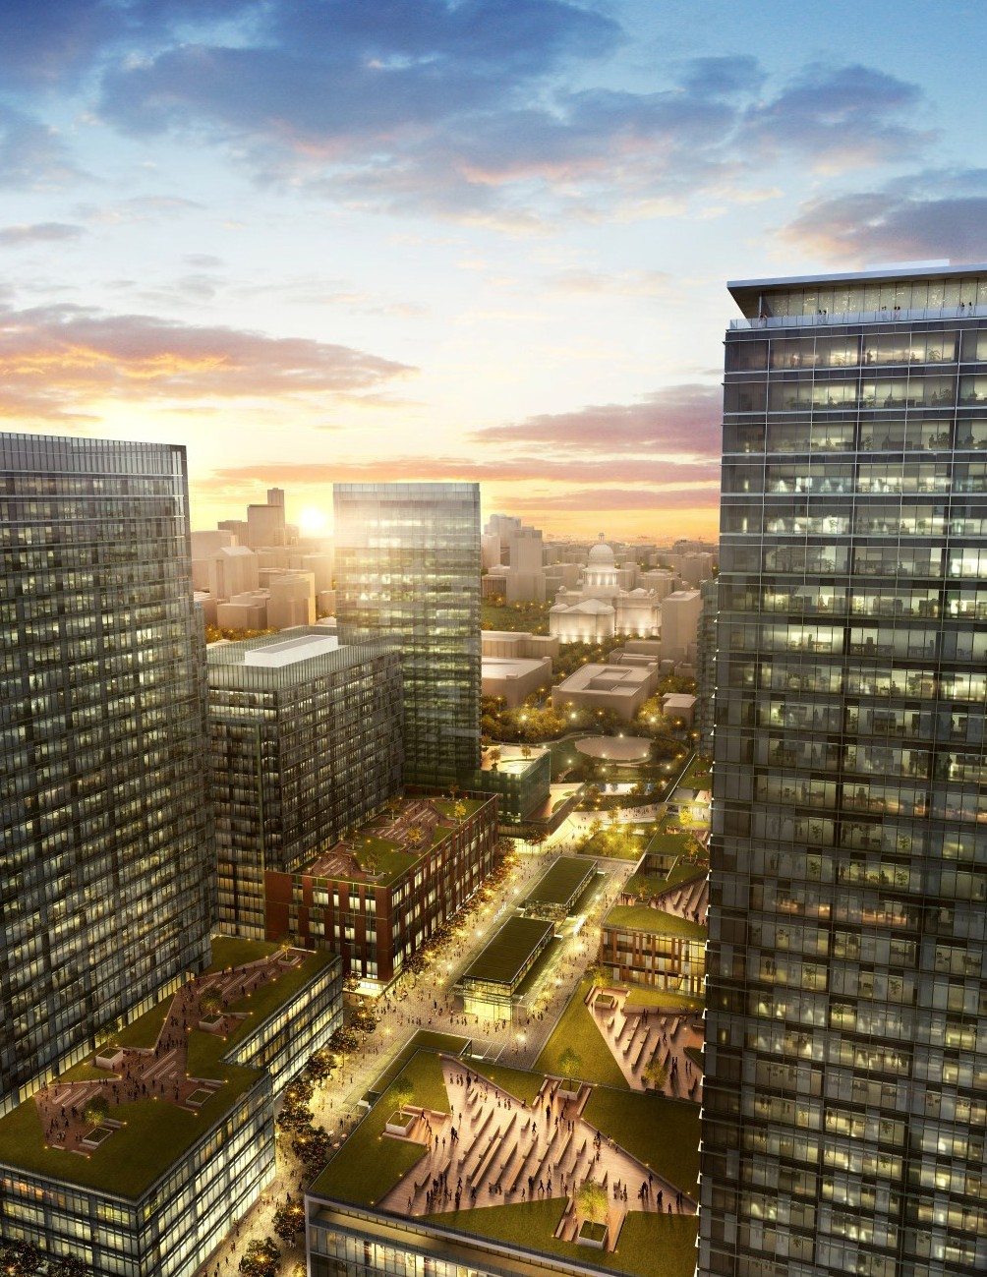
II. REQUEST FOR
QUALIFICATIONS PROCESS AND REQUIREMENTS

Slide 25
A. Purchasing Supervisor
Central Health has designated a Purchasing Supervisor who is responsible for the conduct of this solicitation process on behalf of Central Health, and whose name, address and e-mail address are listed below.
All deliveries (including response delivery) should be addressed as follows:
Central Health
Request for Qualifications (RFQ) No. 1609-001 Central Health Brackenridge Campus Mixed- Use Development
Attn: Norma Williams, Purchasing Supervisor 1111 East Cesar Chavez Street
Austin, TX 78702
Any inquiries or requests regarding this RFQ should be submitted to the Purchasing Supervisor as identified on BidSync and Central Health’s Website; http://www.centralhealth.net/purchasing/bid-sync/.
Respondents may ONLY contact the Purchasing Supervisor regarding the solicitation. Respondents should not contact individual Central Health board members, management, Central Health's Master Plan consultants, or staff regarding this solicitation. Such contact may result in disqualification of the respondent initiating the contact.
B. Definition of Terminology
This section contains definitions and abbreviations that
are used throughout this procurement document.
“BidSync Website” is the following link: www.bidsync. com/travis-county-healthcare-district/
“Central Health Website” is the following link: www. centralhealth.net/current_solicitations.html
“Evaluation Committee” means a body appointed by Central Health management to perform the evaluation of responses.
“Electronic State Business Daily” (ESBD) is the following link: esbd.cpa.state.tx.us/
“Respondent” is any person, corporation, or partnership who submits a response.
“Purchasing Supervisor” means the person or designee authorized by Central Health to manage or administer a procurement requiring the evaluation of competitive sealed responses.
“Request for Qualifications” or “RFQ” means all documents, including those attached or incorporated by reference, used for soliciting responses.
“Responsive response” means a response that conforms in all material respects to the requirements set forth in the Request for Qualifications.
“Shortlist” means a list of selected respondents from
which a final choice is made.
SEPT EMBER 1, 2016 www.centralhealth.net/purchasing/bid-sync/ 17

Slide 26
C. Sequence of Events
The Purchasing Supervisor will make every effort to adhere to the following schedule:
Step 1 RFQ Process (Events 1-8)
Action | Responsibility | Date
1. Issuance of RFQ | Central Health | Sept. 1, 2016
2. Pre-response meeting and site tour | Central Health | Sept. 15, 2016
3. Deadline to submit RFQ questions | Potential respondents | Sept. 23, 2016
4. Response to written questions | Central Health | Sept. 30, 2016
(In the form of RFQ addendum)
5. Deadline to submit RFQ response | Potential respondents | Oct. 21, 2016
6. RFQ response evaluations | Evaluation Committee | November/December 2016
7. RFQ respondent interviews | Evaluation Committee | November/December 2016
8. RFQ shortlist notification | Central Health | December 2016
9. Issuance of RFP (Step 2) | Central Health | January 2017
Respondents who received notification of this solicitation by means other than through Central Health may contact the Purchasing Supervisor herein to request to be added to the vendor list. Inclusion on the vendor list is the only way to ensure timely notification of any addenda and/or information that may be issued prior to the solicitation submittal date.
IT IS THE RESPONDENT’S SOLE RESPONSIBILITY TO ENSURE THAT HE/SHE RECEIVES ANY
AND ALL ADDENDA FOR THIS RFQ by either informing Central Health of his/her email information or by regularly checking the following Websites; addenda will be posted on the website the day they are released:
http://www.centralhealth.net/purchasing/bid-sync/
esbd.cpa.state.tx.us/
www.bidsync.com/travis-county-healthcare-district/
The following paragraphs describe the activities listed in the sequence of events.
18 CENTRAL HEALTH BRACKENRIDGE CAMPUS RFQ

Slide 27
D. Explanation of Events
5. Deadline to Submit RFQ Response
THE PURCHASING SUPERVISOR OR DESIGNEE MUST RECEIVE ALL RESPONSES FOR REVIEW AND EVALUATION NO LATER THAN 2 P.M. CENTRAL STANDARD TIME ON Fri. Oct. 21, 2016.
Responses received after this deadline will not be accepted. The date and time of receipt will be recorded on each response. The response must be addressed and delivered to the Purchasing Supervisor or her designee at the address listed in Section II, A.
Responses must be sealed and labeled on the outside of the package and clearly indicate they are in response to: Request for Qualifications (RFQ) No. 1609-001, Central Health Brackenridge Campus Mixed-Use Development. Responses submitted by facsimile or other electronic means will not be accepted.
All respondents are expected to carefully examine the RFQ documents. Any ambiguities or inconsistencies should be brought to the attention of the Purchasing Supervisor. It is Central Health’s intent that all information necessary to complete a response is included in this RFQ. It is the responsibility of the respondents to obtain clarification of any information contained herein that is not fully understood.
Central Health is responsible for the interpretation of the wording of this RFQ. Answers to inquiries regarding the RFQ’s content will only be given in writing. Any verbal statement regarding the RFQ
prior to the award shall be considered non-binding. The only formal interpretation of the RFQ will be made by RFQ amendment or addendum issued by the Purchasing Supervisor. A copy of such amendment or addendum will be posted on BidSync, Electronic State Business Daily (ESBD), and Central Health’s website.
1. Issuance of RFQ
This RFQ is being issued by Central Health on September 1, 2016, and has been posted on the indicated websites as well as advertised in local and national publications.
2. Pre-Response Meeting and Site Tour
At 9 a.m. Central Standard Time on Sept. 15, 2016, Central Health will host a meeting for interested developers and other potential participants at the Dell Medical School Health Learning Building located at 1501 Red River St., 5th floor board room, Austin,
TX, 78701. The meeting will include a presentation by Central Health, a walking tour of the Site, and a question-and-answer session. While attendance is not mandatory, potential respondents are encouraged to participate. The meeting and site tour are expected to take four hours. Lunch will be provided.
3. Deadline to Submit Questions
Potential respondents may submit additional written questions as to the intent or clarity of this RFQ until close of business (COB) Sept. 23, 2016. All written questions must be submitted via e-mail to the Purchasing Supervisor.
4. Response to Written Questions/RFQ Addenda
Written responses to written questions will be addressed in the RFQ addendum and will be distributed by close of business September 30, 2016 via BidSync, the Electronic State Business Daily (“ESBD”) and Central Health website to all potential respondents.
SEPT EMBER 1, 2016 www.centralhealth.net/purchasing/bid-sync/ 19

Slide 28
6. RFQ Response Evaluations
An Evaluation Committee appointed by Central Health management will evaluate the responses. The Purchasing Supervisor may initiate discussions with respondents who submit a responsive or potentially responsive RFQ for the purpose of clarifying aspects of the RFQ, but RFQs may be accepted and evaluated without such discussion. Discussions SHALL NOT be initiated by respondents. The Evaluation Committee will evaluate and score written responses using the evaluation criteria identified in Section V.
The respondent who filed the appeal shall be notified of the time and place the appeal is to be heard by Central Health and afforded an opportunity to present evidence in support of the appeal. Central Health’s decision is final.
Protests received after the deadline will not be accepted
F. General Requirements
1. Acceptance of Conditions Governing the Solicitation
Respondents must indicate their acceptance of the Conditions Governing the Solicitation section in the letter of transmittal. Submission of a response constitutes acceptance of the evaluation criteria contained in Section V of this RFQ.
7. RFQ Respondent Interviews and Selection of Short List to Receive the RFP
Based on the scoring of the written responses, the Evaluation Committee will identify respondents who will be required to participate in interviews with the Evaluation Committee. Following those interviews, the Evaluation Committee will combine the scores from the written responses and the interviews to identify a shortlist of respondents. Only shortlisted respondents will be invited to participate in Step 2 of the master developer selection process: a Request for Proposal (RFP) will be issued by Central Health estimated on or around January 2017.
2. Incurring Cost
Any cost incurred by the respondent in preparation, transmittal, presentation of any response or material submitted in response to this RFQ shall be borne solely by the respondent.
3. Amended Responses
A respondent may submit an amended response before the deadline for receipt of responses. Such amended responses must be complete replacements for a previously submitted response and must be clearly identified as such in the transmittal letter.
Central Health personnel will not merge, collate, or assemble response materials.
E. Protest Deadline
Protest after the shortlist selection must be submitted in writing to the Purchasing Supervisor within 10 calendar days after public announcement of the shortlist by Central Health. The Purchasing Supervisor shall rule
on the protest in writing within ten 10 calendar days from date of receipt. Any appeal of the Purchasing Supervisor’s decision must be made within 10 calendar days after receipt thereof and submitted to the Purchasing Supervisor, who shall present the matter for final resolution to the Central Health President and CEO or her designee.
20 CENTRAL HEALTH BRACKENRIDGE CAMPUS RFQ

Slide 29
4. Respondent’s Rights to Withdraw Response
Respondents will be allowed to withdraw his/her response at any time prior to the deadline for receipt of responses. The respondent must submit a written withdrawal request signed by the respondent’s duly authorized representative addressed to the Purchasing Supervisor.
The approval or denial of withdrawal requests received after the deadline for receipt of the respondents is governed by the applicable procurement regulations.
6. Termination
This RFQ may be canceled at any time and any and all respondents may be rejected in whole or in part, if
Central Health determines such action to be in the best interest of Central Health.
7. Sufficient Appropriation
Any selection of short-listed respondents as a result of this RFQ process may be terminated if sufficient appropriations or authorizations do not exist. Such termination will be effected by sending written notice to the respondents. Central Health’s decision as
to whether there are sufficient appropriations and authorizations will be accepted by the respondent as final.
5. Disclosure of Response Contents
It is Central Health’s intention that responses be kept confidential until a contract is awarded. At that time, all responses and documents pertaining to
the responses will be open to the public, except for any material that is identified as being proprietary or confidential. The Purchasing Supervisor will not disclose or make public any pages of a response on which the respondent has stamped or imprinted “proprietary” or “confidential” unless required to by law or regulation. Proprietary or confidential data as
identified by the respondent shall be readily separable from the response in order to facilitate eventual public inspection of the other portions of the response.
If a request is received by Central Health for disclosure of data which the respondent has identified as proprietary or confidential, the respondent will receive notice from Central Health pursuant to the requirements outlined in the Texas Public Information Act. Unless the respondent takes legal action to prevent the disclosure, the response will be disclosed. The response shall be open to public inspection subject to any continuing prohibition on the disclosure of confidential data.
8. Legal Review
Central Health requires that all respondents agree to be bound by the General Requirements contained in this RFQ. Respondent’s concerns must be promptly brought to the attention of the Purchasing Supervisor.
9. Basis for Response
Only information supplied by Central Health in writing through the Purchasing Supervisor or in this RFQ should be used as the basis for the preparation of responses.
10. Respondent Qualifications
The Evaluation Committee may make such investigations as necessary to determine the ability of the respondent to adhere to the objectives specified within this RFQ. The Evaluation Committee will reject the response of any respondent who is deemed not responsive by Central Health.
SEPT EMBER 1, 2016 www.centralhealth.net/purchasing/bid-sync/ 21

Slide 30
11. Right to Waive Minor Irregularities
The Evaluation Committee reserves the right to waive minor irregularities. The Evaluation Committee also reserves the right to waive mandatory requirements, provided all of the otherwise responsive submittals failed to meet the mandatory requirements and/
or doing so does not otherwise materially affect the short-listing process. This right is at the sole discretion of the Evaluation Committee.
14. Right to Publish
Throughout the duration of this master developer solicitation two-step process, potential respondents must secure from Central Health written approval prior to the release of any information that pertains to the potential work or activities covered by this RFQ or a subsequent contract resulting from the solicitation process. Failure to adhere to this requirement may result in disqualification of the response.
12. Change in Respondent’s Representatives
Central Health reserves the right to require a change in responder’s representatives if the assigned representatives will not or cannot, in the opinion
of Central Health, meet the needs of the project adequately.
15. Ownership of Responses
All documents submitted in response to this RFQ shall
become the property of Central Health.
16. Electronic Mail Address Required
A large part of the communication regarding this RFQ process will be conducted by electronic mail (e-mail). Respondents must provide a valid e-mail address to receive correspondence.
13. Central Health’s Rights
Central Health may:
Reject any or all responses and discontinue the RFQ process without obligation or liability to any respondent;
Waive any defect, irregularity or informality in any response;
Accept responses from one or more entities;
Procure the services in whole or in part by other means;
Award more than one contract;
Not award any contract.
17. Use of Electronic Versions of this RFQ
This RFQ is being made available by electronic means. If accepted by such means, the respondent acknowledges and accepts full responsibility to ensure that no changes are made to the RFQ. In the event of conflict between a version of the RFQ in the respondent’s possession and the version maintained by Central Health, the version maintained by Central Health shall govern.
22 CENTRAL HEALTH BRACKENRIDGE CAMPUS RFQ

Slide 31
18. Historically Underutilized Business (HUB) Program and Good Faith Effort
It is Central Health’s policy that HUBs have the maximum opportunity to participate in the performance of Central Health’s contracts and
subcontracts. Respondents shall be required to make a good faith effort to take all necessary and reasonable steps to ensure HUBs have the maximum opportunity to participate as contractors and subcontractors.
To be eligible under this program, HUB contractors and subcontractors must be certified as a HUB, Minority/Women-Owned Business Enterprises, or Disadvantaged Business Enterprise by a recognized governmental program, such as:
Providing notice of opportunities to minority or women trade organizations or development
centers to assist in identifying potential HUBs by disseminating the information to their members/ participants.
In the RFP process, Step 2 of the solicitation process, additional information regarding HUB outreach and engagement for this Central Health project will be required.
19. Suspension and Debarment Requirement
At the proposal stage (Step 2), the respondent shall certify, by signing the agreement attached hereto as Acknowledgement of Receipt Form, Attachment A that to the best of its knowledge and belief that the respondent and/or its principals are not or have not been debarred, suspended, proposed for debarment or declared ineligible for the award of contracts by any federal department or district.
City of Austin Municipal Government;
Texas Unified Certification Program;
State of Texas; or
Other
To the extent practical and consistent with standard and prudent industry practices, minimum good faith efforts may include the following but are not limited to:
20. Conflict-of-Interest/Disclosure Questionnaires
Pursuant to Chapter 176 of the Texas Local Government Code, entities submitting responses during the RFQ stage of the Developer Solicitation Process shall be required to complete and submit the Conflict-of-Interest Questionnaire (CIQ) attached to this RFQ as Attachment B. For additional information concerning the submittal of the CIQ, visit www. centralhealth.net/purchasing/conflict-of-interest- disclosures/conflict-of-interest-questionnaires-link-to- alphabetized-list/
Dividing the project into the smallest feasible portions, to allow for maximum HUB subcontractor participation;
Providing to HUBs that exhibited genuine interest in bidding on a subcontract adequate information regarding the project (i.e. plans, specifications, scope of work, bonding and insurance requirements and a point of contact within respondent’s organization);
Notifying, in writing, three or more HUBs for each scope of work, allowing no less than five working days prior to bid submission, of the planned work to be subcontracted; and
SEPT EMBER 1, 2016 www.centralhealth.net/purchasing/bid-sync/ 23

Slide 32
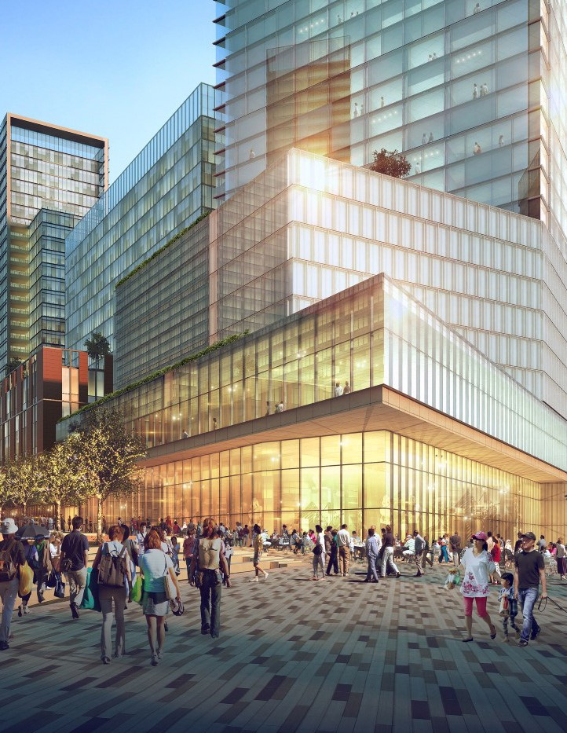
III. RESPONSE FORMAT AND ORGANIZATION

Slide 33
This section describes the format and organization of the respondent’s response. Failure to conform to these specifications may result in the disqualification of the response.
Within each section of the response, respondents should address the items in the order in which they appear in this RFQ. All forms provided in the RFQ must be thoroughly completed and included in the appropriate section of the response.
Any response that does not adhere to these requirements may be deemed non-responsive and rejected on that basis.
The response summary may be included by respondents to provide the Evaluation Committee with an overview of the response; however, this material will not be used in the evaluation process unless specifically referenced in other portions of the response.
A. Number of Responses
Respondents shall submit only one response.
B. Number of Copies
Respondents shall deliver one original hard copy of their response, 10 identical hard copies and one electronic identical copy on a flash drive along with confidential financial information under separate cover, to the location specified in Section II, A on
or before the closing date and time for receipt of responses.
C. Response Format – Mandatory
All responses must be printed in hard copy and placed within a binder with tabs delineating each section.
1. Response Organization
The response must be organized and indexed in the following format and must contain, as a minimum, all listed items in the sequence indicated.
Cover Letter
Table of Contents
Response Summary (optional)
Statement of Qualifications
Completed and Signed Acknowledgement of
Receipt Form (Attachment A)
Completed and Signed CIQ (Attachment B)
Completed and Signed Certificate of Secretary, if respondent is a corporation (Attachment C)
SEPT EMBER 1, 2016 www.centralhealth.net/purchasing/bid-sync/ 25

Slide 34
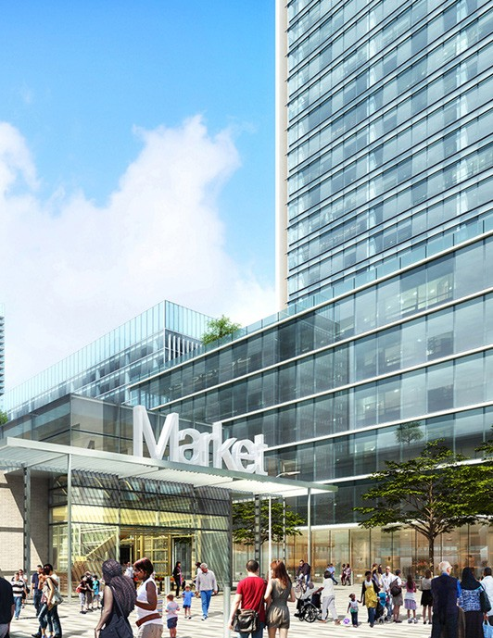
IV. CONTENTS FOR STATEMENT OF QUALIFICATIONS

Slide 35
Central Health has particular interest in developers with a demonstrated, successful record with similar master developer projects in redeveloping urban settings. Experience in mixed-use development projects including retail, restaurant, hotel, housing, office, health-related uses and purposes, entertainment and civic uses. Interested developers are invited to provide a Statement of Qualifications, responding
to the topics described below. Please organize the Statement of Qualifications as follows, responding to all of the sections and subsections in (A) through (D).
B. Financial Qualifications
To the extent allowed by law, Central Health and its consultants will maintain the confidentiality of certain financial information provided by respondents as a part of the Statement of Qualifications review process. Respondents shall provide proprietary financial information under separate cover.
1. Financial Capacity
Respondents should be prepared to fund/finance the full cost of the project, including pre-development costs, infrastructure and Site preparation, and vertical construction. Respondents should provide a description of their financial capacity and backing, including general financial capabilities, partnerships
and current available credit lines. Respondents should describe their need for and ability to raise equity
and additional capital sources. Respondents should describe how pre-development costs will be funded.
A. Development Entity
1. Developer Description
Provide a brief description (up to five pages) of the respondent including narrative and quantitative metrics such as number of employees, dollar volume per year, and office locations, and other descriptive information. Submission should include portfolio information such as locations and status of projects, project type and size, and attributes relevant to Central Health’s objectives, among other descriptive information.
Detailed Financial Qualifications
In order to demonstrate access to equity capital and financing resources to carry out development of the property, provide the information indicated below:
  Composition of current real estate portfolio.
  Recent history (last five years) in obtaining financing commitments, detailing type of project, financing source, and amounts committed.
  Projects in pipeline, including: status, development schedule and financial commitment required of developer, and a description of project financing methods, sources, and amounts.
2. Development Team
In two to three pages, identify the development team, including key participants to be involved in the project. The primary focus should be on the developers and investors (if known), and key team consultants and contractors.
3. Team Roles
In two to three pages, identify the roles for the project manager and key individuals who will be involved in the design, financing, development, implementation, and operation of the development. Resumes (no
more than two pages each) for key personnel may be provided in addition to this brief summary in an appendix.
SEPT EMBER 1, 2016 www.centralhealth.net/purchasing/bid-sync/ 27

Slide 36
  Audited financial statements for the past three years. If audited financial statements are not available, respondent shall provide the last three years of IRS tax returns. If the respondent would like the Purchasing Supervisor to maintain the confidentiality, to the extent allowed by the law, of this portion of the response, please place under separate cover and mark documents confidential (see Section II, F.5).
  Specific sources of debt/equity capital that may be used for the project, including relationship to the respondent (outside lender, parent company, etc.) and contact information.
  If applicable, bond credit rating(s) by industry standard rating agency such as Moody’s Investors Service, Standard & Poor’s Financial Services LLC and Fitch Ratings.
  Adverse actions, if any, taken by any funding sources or financial institutions against the respondent or its joint venture partner(s), such as terminating or restricting the use of funds anytime during the past five years.
  Litigation, if any, in which respondent (and any related, affiliated entities) is involved or settled over the last five years.
For each project identified by the respondent, please
provide the following information:
  Project name and type.
  Location, including address, and photograph(s).
  Size, mix of uses, and key tenants.
  Development timeline (from developer selection/ site control to completion of construction, indicating phasing as relevant).
  Project cost, capital and financing sources used,
and indications of economic performance.
  General description, including role of development team and key project personnel, unique challenges of project, occupancy and history.
  Past use of Historically Underutilized Businesses (HUBs), including experience with outreach efforts aimed at enhancing opportunities for HUBs to subcontract.
  Identification of developer and team.
  Living Wage experience as it applies to a mixed- use project.
2. Respondent’s Honors
Please also identify a maximum of three (3) completed projects of any type for which the respondent received an award for design excellence, market performance, community benefits or sustainability from a recognized organization, and provide background information for each project.
C. Experience
1. Respondent’s Experience
Describe the relevant development experience of the respondent. List a minimum of two and a maximum of five projects that are most comparable to this project.
Similar projects include those with one or more of the following types of attributes: (1) high-density, mixed-use, multi-phased master developments, (2) mixed-income housing, environmental sustainability, and/or other community benefits, (3) inclusion of health-related uses or purposes (4) public markets and/or ground-floor retail, (5) development on long-term ground lease, and
(6) substantive public outreach process, among others.
3. Respondent’s Team Members’ Experience
Please provide relevant experience of the development team members, identifying key team member firms and staff members that will be assigned to this
project. Provide no more than three projects per team member. Provide information, including the
project name, location, description, services provided,
dates of service, and outcome of work effort. These
28 CENTRAL HEALTH BRACKENRIDGE CAMPUS RFQ

Slide 37
projects may be, and are encouraged to be, the same as those submitted under sections IV, C.1. Respondent Experience and IV, C.2. Respondent’s Honors.
2. Regulatory, Political and Community Context
Summarize the respondent’s understanding of the regulatory, political, and community context, and any strategies that could be applied to this project, based upon your experience on other projects.
4. Local Experience
Provide a statement describing the team’s knowledge and any experience with the City of Austin’s Land Development Code and ordinances, Austin’s development review and permitting processes, State of Texas law, and other applicable laws relevant to the respondent’s ability to implement the project.
3. Approach to Developing an Implementation Plan
Summarize the respondent’s understanding of the process required for redevelopment of the property, including the context for investigating, planning and redeveloping the property. Include examples from projects described in Section C, Experience—to illustrate successful strategies applied in previous planning and implementation efforts. Include key project milestones or achievements that will help to
achieve a successful project. If the respondent foresees or requires roles for Central Health, the master developer, or other entities that are different than those described under Section I, C of this RFQ, such differences should be noted. Note that Site diagrams, bubble plans, plan renderings or any other design work are not required in this RFQ response.
5. Experience Working with Government and/or Non-Profit Organizations in Urban Environments
Describe experience with development in urban environments and past experiences with governmental and/or non-profit entities.
6. References
Please provide at least three references from comparable projects described under Section IV, C.1. for the respondent, including public and private entities.
Provide complete contact information, including: name, title, organization/company, address, e-mail, phone and description of past relationship.
4. Commentary on the Master Plan
Summarize the respondent’s understanding of the Brackenridge Campus Master Plan (adopted by Central Health, January 2016), and any preliminary ideas regarding its implementation, such as but not limited to appropriate densities, mixes of use and/or targeted tenant profiles, or infrastructure and parking programs. If certain aspects of the Master Plan are perceived to represent particular challenges or unique opportunities, please describe the implications of those factors. Again, no specific design work is required
at this time, but Central Health seeks to understand whether the respondent believes the Master Plan is practicable or may require major amendments.
D. Project Understanding and Approach
1. Physical and Market Context and Development Opportunities and Constraints
Describe the key opportunities and constraints as you see them from a market and planning perspective, and your experience addressing such issues or opportunities on past projects.
SEPT EMBER 1, 2016 www.centralhealth.net/purchasing/bid-sync/ 29

Slide 38
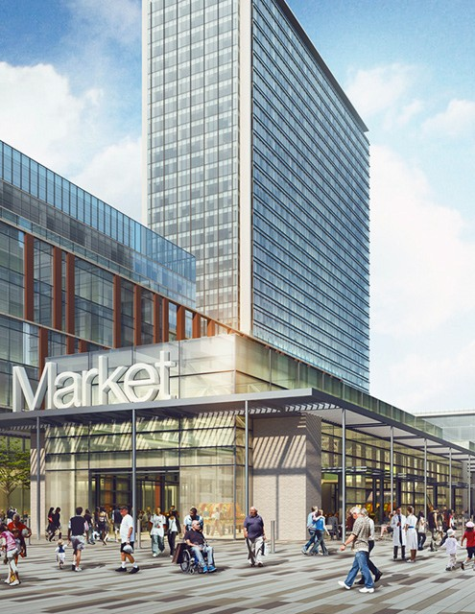
V. EVALUATION CRITERIA

Slide 39
As part of selecting the top-ranked respondents for the shortlist and advancement to Step 2, the RFP Process, Central Health will utilize a formal evaluation process involving consideration of the responses based on the RFQ evaluation criteria described below.
C. Project Understanding and Approach
The Evaluation Committee will prioritize respondents demonstrating superior understanding of conditions affecting the development opportunity, and those with appropriate experience and ideas for addressing these conditions and successfully implementing the project.
A. Financial Qualifications
The Evaluation Committee will evaluate the respondent’s demonstration of a credible ability to provide and/or leverage adequate funds to support all costs, including pre-entitlement and other pre- development costs as well as required infrastructure, site preparation, and vertical development costs.
Financial strength at this stage will be based upon the respondent’s financial record and successful financing of comparable projects.
D. Firm and Individual Team Member Experience
The Evaluation Committee will evaluate the experience of the respondent and the specific individuals proposed for assignment on the project.
E. References
B. Comparable Project Experience
References will be contacted by Central Health and/or its consultants for feedback related to the respondent’s performance as well as funding and financing. The Evaluation Committee also reserves the right to contact individuals not listed by the respondents
as references but who have material knowledge of the process and outcomes of the respondents’ past projects.
Respondents may be asked to provide assistance with the coordination of reference calls.
Experience working on similar projects in similar contexts will be evaluated. Experience working with a public entity landowner will be valued strongly.
This criterion will include demonstrated experience with successful high-density, mixed-use projects, as well as health-related development and public partner experience.
Weighting Criteria for Evaluation:
Criteria | Points
Financial Qualifications | 40
Comparable Project Experience | 20
Project Understanding and Approach | 20
Firm and Individual Team Member Experience | 20
Total Points of Written Responses | 100
Interview | 25
SEPT EMBER 1, 2016 www.centralhealth.net/purchasing/bid-sync/ 31

Slide 40
F. Interview
G. Step 2 RFP Process
Based on the scoring of the written responses, respondents will be identified to participate in required interviews with the Evaluation Committee. Following those interviews, the Evaluation Committee will combine the scores from the written responses and the interviews to identify a shortlist of respondents. Only shortlisted respondents will be invited to participate in Step 2 of the master developer selection process. The Request for Proposal (RFP) is estimated to be issued by Central Health in January 2017.
The Purchasing Supervisor will contact respondents to set up an interview with the Evaluation Committee. The interview format will be structured and consistent for all respondents with questions designed to further clarify their RFQ response.
The Evaluation Committee will recommend a number of respondents deemed most qualified to develop
the Site. The shortlisted respondents will be notified in writing of their advancement to Step 2 of this procurement process. The response to the RFP will involve more details of the development project and terms of the transaction between the respondent and Central Health. In general, the RFP responses are expected to include:
Refined development concepts, including narrative and graphics relating the proposed project to the Central Health Brackenridge Campus Master Plan;
Implementation strategies, including pre- development efforts, construction phasing concepts, and the respondent’s intentions to construct and/or operate various project
components versus offering development sites to
third parties;
Financial proposal terms, including ground lease revenue and other forms of financial participation for Central Health; and
Project management proposals, including commitments of key personnel and plans for community and jurisdictional engagement.
32 CENTRAL HEALTH BRACKENRIDGE CAMPUS RFQ

Slide 41
SEPT EMBER 1, 2016 www.centralhealth.net/purchasing/bid-sync/ 33

Slide 42
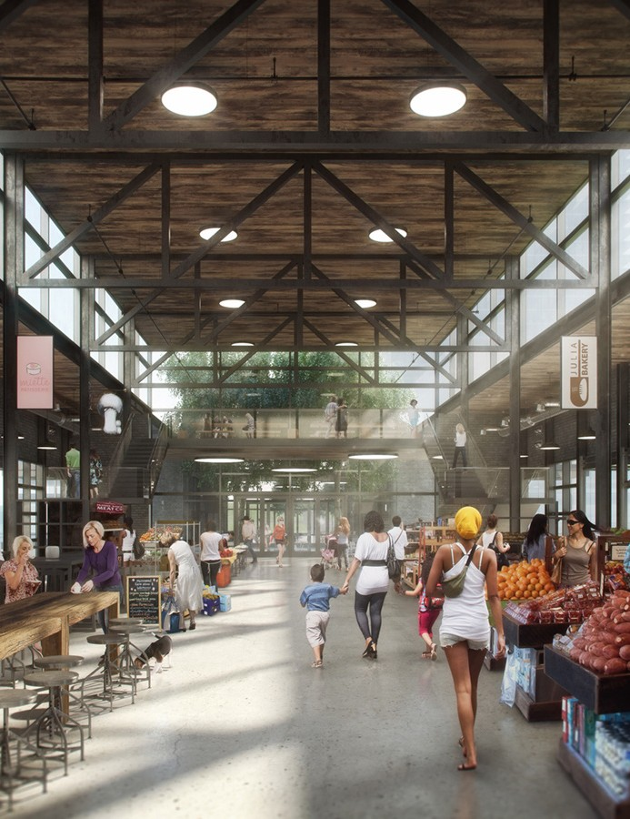
VI. ATTACHMENTS

Slide 43
Attachment A
Acknowledgment of Receipt Form
In acknowledgment of receipt of this Request for Qualifications the undersigned agrees that he/she has received a
complete copy, beginning with the title page and table of contents, and ending with Attachment C.
The acknowledgment of receipt should be signed, returned, and included with the respondent's submittal. Complete (Legal) Name of respondent:
Respondent Tax Identification Number: Business Address: Telephone Number: Type of Organization: Individual Partnership Corporation Association
Other (please describe) If incorporated, state of incorporation: Date organization was formed (month/year): The number of years providing services/systems similar to those requested in this RFQ:
Description of respondent’s organization, locations, and number of staff (including subcontractors as ap- plicable) that will provide services/support outlined in this RFQ):
Please certify the following by placing an “X” in the appropriate column:
Certification | Yes | No
Is respondent currently in the process of filing for bankruptcy?
Has respondent filed for bankruptcy within the past five (5) years?
Do you certify that the respondent does not owe taxes to Travis County?
Do you certify that the respondent is not currently under suspension or debar- ment by any governmental entity (City of Austin/state/federal government)?
Do you acknowledge that if the respondent is currently under suspension or debar- ment, its submittal may not be considered?
SEPT EMBER 1, 2016 www.centralhealth.net/purchasing/bid-sync/ 35

Slide 44
Individual authorized to bind respondent to contract:
Name/Title:
Telephone: E-mail:
Point of contact information for this RFQ (if different from authorized individual):
Name/Title:
Telephone: E-mail:
Respondent Historically Underutilized Business (HUB) Declaration
Are you certified as a HUB or a Minority Business Enterprise/ Women Business Enterprise/Disability Business Enterprise source? | Yes | No
Important: The proposer/respondent must respond to all questions. The proposer/respondent may attach additional docu- ments to the questionnaire to provide additional details.
Authorized Respondent Signature
Date
36 CENTRAL HEALTH BRACKENRIDGE CAMPUS RFQ

Slide 45
Attachment B
CONFLICT OF INTEREST QUESTIONNAIRE
For vendor doing business with local governmental entity
FORM CIQ
This questionnaire reflects changes made to the law by H.B. 23, 84th Leg., Regular Session.
This questionnaire is being filed in accordance with Chapter 176, Local Government Code, by a vendor who has a business relationship as defined by Section 176.001(1-a) with a local governmental entity and the vendor meets requirements under Section 176.006(a).
OFFICE USE ONLY
Date Received
By law this questionnaire must be filed with the records administrator of the local governmental entity not later than the 7th business day after the date the vendor becomes aware of facts that require the statement to be filed. See Section 176.006(a-1), Local Government Code.
A vendor commits an offense if the vendor knowingly violates Section 176.006, Local Government Code. An offense under this section is a misdemeanor.
1
Name of vendor who has a business relationship with local governmental entity.
2
Check this box if you are filing an update to a previously filed questionnaire. (The law requires that you file an updated
completed questionnaire with the appropriate filing authority not later than the 7th business day after the date on which you became aware that the originally filed questionnaire was incomplete or inaccurate.)
3
Name of local government officer about whom the information is being disclosed.
Name of Officer
4
Describe each employment or other business relationship with the local government officer, or a family member of the
officer, as described by Section 176.003(a)(2)(A). Also describe any family relationship with the local government officer. Complete subparts A and B for each employment or business relationship described. Attach additional pages to this Form CIQ as necessary.
Is the local government officer or a family member of the officer receiving or likely to receive taxable income, other than investment income, from the vendor?
Yes No
Is the vendor receiving or likely to receive taxable income, other than investment income, from or at the direction of the local government officer or a family member of the officer AND the taxable income is not received from the local governmental entity?
Yes No
5
Describe each employment or business relationship that the vendor named in Section 1 maintains with a corporation or
other business entity with respect to which the local government officer serves as an officer or director, or holds an ownership interest of one percent or more.
6
Check this box if the vendor has given the local government officer or a family member of the officer one or more gifts as described in Section 176.003(a)(2)(B), excluding gifts described in Section 176.003(a-1).
7
Signature of vendor doing business with the governmental entity
Date
SEPT EMBER 1, 2016 www.centralhealth.net/purchasing/bid-sync/ 37

Slide 46
CONFLICT OF INTEREST QUESTIONNAIRE
For vendor doing business with local governmental entity
A complete copy of Chapter 176 of the Local Government Code may be found at http://www.statutes.legis.state.tx.us/ Docs/LG/htm/LG.176.htm. For easy reference, below are some of the sections cited on this form.
Local Government Code § 176.001(1-a): "Business relationship" means a connection between two or more parties based on commercial activity of one of the parties. The term does not include a connection based on:
a transaction that is subject to rate or fee regulation by a federal, state, or local governmental entity or an agency of a federal, state, or local governmental entity;
a transaction conducted at a price and subject to terms available to the public; or
a purchase or lease of goods or services from a person that is chartered by a state or federal agency and that is subject to regular examination by, and reporting to, that agency.
Local Government Code § 176.003(a)(2)(A) and (B):
  A local government officer shall file a conflicts disclosure statement with respect to a vendor if:
***
    the vendor:
      has an employment or other business relationship with the local government officer or a family member of the officer that results in the officer or family member receiving taxable income, other than investment income, that exceeds $2,500 during the 12-month period preceding the date that the officer becomes aware that
        a contract between the local governmental entity and vendor has been executed; or
        the local governmental entity is considering entering into a contract with the vendor;
      has given to the local government officer or a family member of the officer one or more gifts that have an aggregate value of more than $100 in the 12-month period preceding the date the officer becomes aware that:
        a contract between the local governmental entity and vendor has been executed; or
        the local governmental entity is considering entering into a contract with the vendor.
Local Government Code § 176.006(a) and (a-1)
A vendor shall file a completed conflict of interest questionnaire if the vendor has a business relationship with a local governmental entity and:
  has an employment or other business relationship with a local government officer of that local governmental entity, or a family member of the officer, described by Section 176.003(a)(2)(A);
  has given a local government officer of that local governmental entity, or a family member of the officer, one or more gifts with the aggregate value specified by Section 176.003(a)(2)(B), excluding any gift described by Section 176.003(a-1); or
  has a family relationship with a local government officer of that local governmental entity.
(a-1) The completed conflict of interest questionnaire must be filed with the appropriate records administrator not later than the seventh business day after the later of:
the date that the vendor:
  begins discussions or negotiations to enter into a contract with the local governmental entity; or
  submits to the local governmental entity an application, response to a request for proposals or bids, correspondence, or another writing related to a potential contract with the local governmental entity; or
the date the vendor becomes aware:
  of an employment or other business relationship with a local government officer, or a family member of the officer, described by Subsection (a);
  that the vendor has given one or more gifts described by Subsection (a); or
  of a family relationship with a local government officer.
Form provided by Texas Ethics Commission
www.ethics.state.tx.us
Revised 11/30/2015
38 CENTRAL HEALTH BRACKENRIDGE CAMPUS RFQ

Slide 47
Attachment C
CERTIFICATE OF SECRETARY
(Required for bidders which are corporations)
I CERTIFY that:
I am the duly qualified and acting Secretary of ,
[Name of Corporation]
A duly organized and existing corporation of the State of .
[Name of State]
The following is a true copy of a Resolution duly adopted by the Board of Managers of such corporation in a meeting legally held on the day of , 20 , and entered in the minutes of such meeting in the minute book of the Corporation.
RESOLVED, that this corporation enter and that , the
[Insert Name of Person Executing Bid Form]
of this corporation, is authorized and directed to execute on behalf of and
[Position with Corporation] as the act of this corporation the Bid Form for the Travis County Healthcare District dba Central
Health , Project # , together with all associated
[Insert Name and Number of Project] documents and, should this corporation be the successful bidder for that project, to execute on behalf of and as the act of the corporation all necessary documents to effect a written contract between this corporation and Travis County Healthcare District d/b/a Central Health for the Construction of the Travis County Healthcare District dba Cen- tral Health , Project # . [Insert Name and Number of Project]
The Secretary is directed to attach a copy of the Bidding Documents to the minutes of this meeting and to make them a part of the corporate records.
The above Resolution is in conformity with the Articles of Incorporation and the Bylaws of the Corporation has never been modified or repealed and is now in full force and effect.
Date Secretary President
SEPT EMBER 1, 2016 www.centralhealth.net/purchasing/bid-sync/ 39

Slide 48
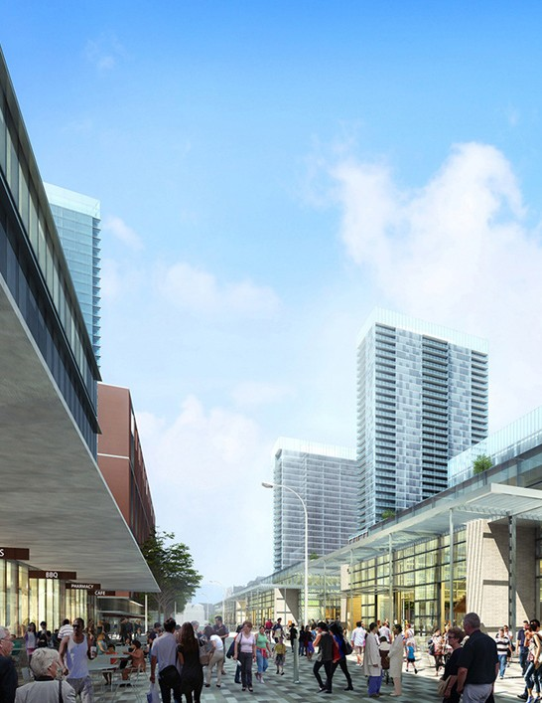
VII. APPENDICES

Slide 49
A. The Guiding Principles and Planning
Parameters
M-2:
Central Health Priorities
Sustain Central Health’s commitment to enhance outpatient specialty care, cancer care, behavioral health services and women’s health services throughout Travis County in the most appropriate locations.
In keeping with transforming best practices in health care delivery, distribute health care services in appropriate facilities and settings throughout Travis County that promote appropriate public access.
Focus any on-campus medical uses along East 15th Street, to take advantage of the proximity to the new Dell Seton Medical Center, the Dell Medical School and supporting facilities in the UT Medical District.
At the outset of more detailed planning for Phase 2 redevelopment (Block 166, 167 and the Original Hospital Block), conduct a programming process with health care
providers and other Central Health partners to better determine such medical and health care uses prior to Phase 2 implementation. At this time, consider including a range of medical, health care and/or wellness-related uses
that could be developed within mixed-use buildings.
Consider including uses that support and/or enhance health care and medical uses.
MISSION: Advance Central Health’s efforts to provide access to health care to those who need it most, and promote Travis County as a model healthy community.
M-1: Health Care Uses
Consider programs and uses for existing and new buildings that advance Central Health’s Strategic Plan and that make the best use of its downtown location.
M-2.1:
M-2.2:
M-1.1:
Develop the Brackenridge Campus as a major, community oriented space that supports Central Health’s mission to provide for
access to health care that will improve health outcomes and overall public health.
Increase health equity and reduce health disparities for Central Health’s constituency through thoughtful building and site design that organizes a synergistic mix of uses, throughout the Brackenridge Campus.
Provide opportunities for early term redevelopment by deconstructing certain buildings, such as the Professional Office Building (POB), the Helipad, the Hospital Tower and its South Wing. Relocate any medical office and clinical uses to remain on the Brackenridge Campus from the POB to the Clinical Education Center (CEC ), or to facilities located within the UT Medical District or other locations, as appropriate.
In partnership with public, non-profit and/ or private entities, develop a permanent, public market focused on healthy food and activities as a major community gathering
space promoting healthy lifestyles for all in the Central Texas region.
M-2.3:
M-1.2:
M-1.3:
M-2.4:
M-3: Healthy Communities
Promote physical activity and improve health with comfortable and safe access to, within and through the site for people of all abilities – whether walking, biking, using transit or driving.
M-1.4:
SEPT EMBER 1, 2016 www.centralhealth.net/purchasing/bid-sync/ 41

Slide 50
M-3.1:
Realign Red River Street and generally reinstate the historic Waller Plan’s grid. Develop streets in concert with the City of Austin, Capital Metro and others as “Complete Streets.” These new streets and pathways will be walkable, bikeable and shaded streets that strive to reduce auto-dependency and to offer “active transportation” connections to adjacent areas – including downtown, the Capitol Complex, UT, the Waller Creek Greenway and East Austin.
Participate in efforts to be led by the
City ofAustin and the Downtown Austin Alliance to create an area-wide, multi-modal transportation and parking management plan to provide employees, patients, residents and visitors convenient mobility choices, while helping reduce vehicle trips and improving air and water quality.
S-1.2:
Balanced with Central Health’s mission, maximize the revenue-generating potential of each of the six redevelopment blocks to support Central Health’s mission throughout Travis County, including that from existing
buildings to remain on the campus during the
first phase of redevelopment.
Keep the existing Main Parking Garage for the foreseeable future to maintain this revenue source to Central Health and to provide parking for the Dell Seton Medical Center.
Enhance the Main Garage by constructing a new “liner” building on its west, Waterloo Park-facing façade that provides ground-floor, pedestrian-oriented uses with leaseable space above. Keep the existing CEC Building and the CEC Parking Garage during Phase 1 of the
project, given their high functionality and their lease revenue.
Expedite the first phase of deconstruction and infrastructure construction to advance the redevelopment of the three Phase 1 blocks so that these buildings may begin generating lease revenue as soon as possible.
Pursue all forms of public, non-profit and private funding, financing and reimbursement for deconstruction, design, construction and maintenance of public streets, open spaces and infrastructure.
S-1.3:
M-3.2:
STEWARDSHIP: Promote uses and programs at the Central Health Brackenridge campus that support the short-and long-term fiscal stability of Central Health and deliver returns for the citizens and taxpayers of Travis County.
S-1: Fiscal Responsibility
Optimize cash flow to Central Health, make wise and effective use of taxpayer dollars, and attract new revenue to support Central Health’s mission.
S-1.1: Maintain maximum flexibility in both the zoning and the development itself to take advantage of unforeseen opportunities, as well to be better able to address unforeseen challenges – such as changing capital market dynamics and changing models of health care delivery.
S-1.4:
S-1.5:
S-2: Meeting Community Needs
Leverage Central Health’s property assets to support ongoing efforts to address community health needs, close gaps in service delivery and achieve Central Health’s priorities.
42 CENTRAL HEALTH BRACKENRIDGE CAMPUS RFQ

Slide 51
S-2.1:
Collaborate with health care partners and the community to promote those uses to be developed in and around the Brackenridge Campus that can most benefit from their physical proximity to the new Dell Seton
Medical Center and the Dell Medical School at The University of Texas at Austin.
Encourage opportunities for combining wellness and health care uses and programs along with other uses that can be located in mixed-use buildings, within and around the Brackenridge Campus.
Recognizing that healthy eating is essential to well-being, provide ground floor uses that feature healthy, affordable and local food
within and outside the public market building and adjacent spaces.
Through partnerships with affordable housing
providers, the development community and other stakeholders, consider a range of housing types in and around the proposed
Innovation Zone, UT and/or the Brackenridge Campus.
S-3.3:
Develop the campus to maximize climate protection and resilience, leveraging the unique opportunity to plan at a district scale of 14 acres. Promote the use of district-scale systems to supply green energy, chilled and hot water, reclaimed water, solar energy, geothermal energy, etc.
Design the campus streets and public spaces to maximize the delivery of “ecosystem services”, such as stormwater management, heat island mitigation, water conservation and reuse, soil and landscape restoration, wildlife habitat, as well as those that improve human health and happiness through contact with nature.
S-2.2:
S-3.4:
S-2.3:
PARTNERSHIP: Strengthen and expand relationships with health and wellness providers, collaborate with other public-sector entities, and help advance the goals of the larger community.
P-1: Stakeholders
Ensure that the low-income, uninsured and underinsured individuals and communities whom Central Health serves continue to receive access to quality health care.
S-2.4:
S-3: Sustainability
Promote efficient use of resources, energy and water; reduce auto dependency; and improve the natural and built environment at and around Central Health’s downtown site.
S-3.1: Require best practices related to green building and natural resource protection – at both the overall campus or district-level and the individual block or building-level of development.
S-3.2: Coordinate the campus’ watershed protection and water management efforts with the City of Austin, State, UT, Travis County, TxDOT, the Waller Creek Conservancy and others.
P-1.1:
Continue with ongoing community engagement activities that keep neighbors, partners and elected officials informed about the ongoing planning and implementation of the Brackenridge Campus project.
Maintain and expand Central Health’s partnerships with health care providers to ensure access to high-quality wellness and health care services, programs and education.
P-1.2:
SEPT EMBER 1, 2016 www.centralhealth.net/purchasing/bid-sync/ 43

Slide 52
P-2: Neighbors
Confer with East Austin residents and support downtown initiatives, including the University of Texas Medical District, the I-35 Corridor Improvement Project, the Waller Creek and Waterloo Park projects, the proposed Innovation Zone, the State Capitol Complex Master Plan, and others.
P-3: Collaborators
Work with the Seton Healthcare Family, Dell
Medical School, health care entities, wellness advocates, business partners and civic and public entities, including Travis County and the City of
Austin.
P-2.1:
Maximize accessibility – physically, socially and economically – to this new neighborhood, through building a community defined by landscaped, walkable streets and a central gathering space and a public market. Develop design guidelines to ensure that buildings and streetscapes are inviting, hospitable and beautiful.
Identify positive benefits that should be maximized during the Brackenridge Campus redevelopment – such as contributing to healthy air quality, clean water, active lifestyle, healthy food, low carbon, etc. – and mitigate environmental and human health stressors associated with conventional development practices.
Work with TxDOT to enhance multi-modal connectivity across I-35 to East Austin, and to create frontage roads that look and feel like “urban boulevards” – with street side trees and wide sidewalks – consistent with the City of Austin’s Downtown Great Streets Program and Complete Streets Policy.
Create a complementary and compatible edge along Waterloo Park that creates vital open space connections between the Waller Creek and the Brackenridge Campus.
Promote a mix of uses that nurtures local economic development, enhances creativity and innovation, promotes a “culture of health,” and creates a vibrant sense of place.
P-3.1:
Collaborate with both the public, non-profit, and private sectors to attract, finance, and operate supportive and complementary uses within the Brackenridge Campus.
Collaborate with public, non-profit and private partners to support the proposed Innovation Zone by creating the kind of place that nurtures innovation focused on wellness and health care. Explore ways in which the uses in and around the public market can support wellness innovation.
Collaborate with the private sector to implement the Brackenridge Campus Master Plan by launching developer solicitation(s) that articulates Central Health’s vision for the property, its goals, its “must-haves,” and respective roles and responsibilities in what will become a public-private partnership.
P-3.2:
P-2.2:
P-3.3:
P-2.3:
P-2.4:
P-2.5:
44 CENTRAL HEALTH BRACKENRIDGE CAMPUS RFQ

Slide 53

B. Proposed Roadway and Open Space Exhibits
G
H
EAST 15TH STREET
G
H
L
L
BLOCK 168
(EXISTING PARKING GARAGE)
A
A
BLOCK 167
F
F
ORIGINAL
K K
HOSPITAL BLOCK
D1/D2
NEW RED RIVER STREET
E
B
EAST 14 TH STREET
J
EXISTING 14TH ST BRIDGE
N
OPEN SPACE
BLOCK #1
 |  | ^{B} OPEN SPACE BLOCK #2
 |  |  | (PUBLIC MARKET & CENTRAL PLAZA)
I-35 SOUTHBOUND FRONTAGE ROAD
N
EAST 13TH 1/2 STREET
E
J
M
D1/D2
BLOCK ^{C}
164
M
C
BLOCK 165
F
SABINE STREET
F
BLOCK 166
OPEN SPACE
BLOCK #3
WATERLOO PARK
Health South
Medical Examiner
AE
Substation
LEGEND
Existing Central Health Property Boundary Per Bilnoski Survey, Dated 9/20/04
Future Block / Parcel Boundaries
Section Cut Reference
Existing Structures Likely to Remain During Phase 1
Brackenridge Campus
Proposed Street and Pathway Plan Phase 1
0 60 120
240 feet
SEPT EMBER 1, 2016 www.centralhealth.net/purchasing/bid-sync/ 45

Slide 54



G
H
EAST 15TH STREET
G
H
L
L
BLOCK 168
(EXISTING PARKING GARAGE)
A
A
F
SABINE STREET
F
K K
BLOCK 167
ORIGINAL
HOSPITAL BLOCK
D1/D2
NEW RED RIVER STREET
E
B
B
EAST 14 TH STREET
J
EXISTING 14TH ST BRIDGE
OPEN SPACE
BLOCK #1
OPEN SPACE BLOCK #2
14TH STREET
I-35 SOUTHBOUND FRONTAGE ROAD
N
(PUBLIC MARKET & CENTRAL PLAZA)
N
EAST 13TH 1/2 STREET
E
J
M
D1/D2
BLOCK ^{C}
164
M
C
BLOCK 165
F F
BLOCK 166
OPEN SPACE
BLOCK #3
WATERLOO PARK
SABINE STREET
Health South
Medical Examiner
AE
Substation
LEGEND
Existing Central Health Property Boundary Per Bilnoski Survey, Dated 9/20/04
Future Block / Parcel Boundaries
Section Cut Reference
EAST 12 TH STREET
Pedestrian Passage at Ground Level of Future Building (Minimum Vertical Clearance = 15’-0”; Minimum Width = 40’-0”)
Existing Main Parking Garage Likely to Remain for Foreseeable Future
Brackenridge Campus
Proposed Street and Pathway Plan Phase 2
0 60 120
240 feet
46 CENTRAL HEALTH BRACKENRIDGE CAMPUS RFQ

Slide 55




EAST 15TH ST
BLOCK 168
BLOCK 167
SABINE ST
ORIGINAL HOSPITAL BLOCK
NEW RED RIVER ST
EAST 14TH ST
2
14TH ST BRIDGE
OPEN SPACE
BLOCK #1
OPEN SPACE BLOCK #2
(PUBLIC MARKET & CENTRAL PLAZA)
E 14TH ST
I-35 SOUTHBOUND FRONTAGE ROAD
OPEN
EAST 13TH 1/2 ST
SPACE
BLOCK #3
BLOCK 164
BLOCK 165
SABINE ST
BLOCK 166
WATERLOO PARK
1
AE
Substation
Health South
Medical Examiner
Intake
Structure
SABINE ST
LEGEND
NOTES
Existing Central Health Property Boundary (Approx. 14.3 Acres)
1
This plan assumes that Red River Street will be relocated as illustrated here, and that the existing Red River ROW (approx. 1.52 acres) will be conveyed to Central Health.
Central Health Property to be Dedicated to COA for Public Streets (Approx. 4.1 Acres)
Central Health Property in Open Space (Approx. 2.8 Acres)
2
This segment of East 14th Street will be dedicated to the City of Austin upon the future deconstruction of the Clinical Education Center Building (CEC).
Brackenridge Campus
Revised Property & Public ROW Dispositions
0 60 120
240 feet
SEPT EMBER 1, 2016 www.centralhealth.net/purchasing/bid-sync/ 47

Slide 56












Section A-A: Red River North of 14th Street Looking North
EXISTING
FUTURE
PARKING
BUILDING
GARAGE
FUTURE BUILDING
SETBACK LINE
Future Building Setback
18’
8'
1'
11'
10'
11' 1'
8'
18'
Sidewalk / Landscape
One-Way Cycle Track
Travel Lane
Turning Lane
Travel Lane
One-Way Cycle Track
Sidewalk / Landscape
32'
Roadway
74' New R.O.W.
Line
Property
Section B-B: Red River Street at Bus Plaza Looking North
Property Line
Open Space Block #1
18’
7’
8’ 8’ 10’
Cycle Track Bus Platform Bus Pullout
11'
11'
10' 8’ 8’
Bus Pullout Bus Platform Cycle Track
7’
18’
Open Space Block #2
Sidewalk
Bio- Filtration
Travel Lane
42'
Roadway
Travel Lane
Bio- Filtration
Sidewalk
124'
New Bus Plaza ROW
48 CENTRAL HEALTH BRACKENRIDGE CAMPUS RFQ

Slide 57






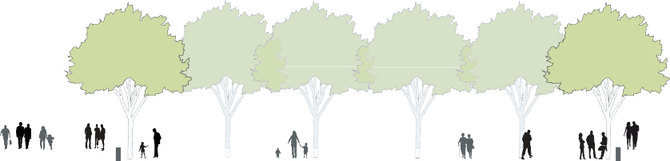

Section C-C: Red River South of 14th Street Looking North
FUTURE
FUTURE
BUILDING
BUILDING
6’
12'
8'
1’
11'
11'
8'
3'
8'
12'
6’
Future Building Setback
Sidewalk/ Landscape
21'
One-Way Cycle Track
Travel Lane
Travel Lane
Parking
One-Way Sidewalk/
Cycle Track Landscape 23'
Sidewalk / Landscape /
Future Building Setback
Sidewalk / Landscape / Cycle Track
30'
Roadway
Cycle Track
74’ R.O.W.
Section D1-D1: Open Space Block #1 Looking East (With Existing Parking Garage Remaining)
EXISTING PARKING GARAGE (BLOCK 168)
Block 168
41’ - 54’ (Varies)
94’ - 104’ (Varies)
18’
Block 164
Sidewalk
~188’
Open Space Block #1
Plaza
Sidewalk / Cafe Zone
SEPT EMBER 1, 2016 www.centralhealth.net/purchasing/bid-sync/ 49

Slide 58








14'
8'
8'
14'
Sharrow
Parking
Parking
Sharrow
18' | 22' | 12' |  | 12' | 22' | 18'
Sidewalk/ | Roadway | Sidewalk/ |  | Sidewalk/ | Roadway | Sidewalk/
Landscape / Cafe Zone | 52' | Landscape | ~83' | Landscape | 52’ | Landscape / Cafe Zone
 | 14th Street R.O.W. |  | Plaza / Potential Public Market Building |  | 13th 1/2 Street R.O.W.
 |  |  | on Open Space Block #2
DRAFT
14TH STREET & 14TH 1/2 STREET LOOKING EAST
Central Health Brackenridge Campus
March 1, 2016
NOTE: Section does not account for topography.
The future development on the north side is about 5 feet higher than the development on the south side.
East 13th 1/2 and East 14th Street may be developed as a curb-less street.

Slide 59





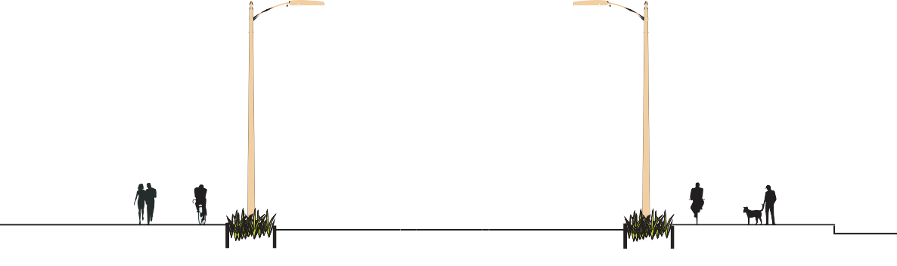





Section F-F: Sabine Street Looking North
10' *
12' *
12' *
10' *
18'
Parking / Drop-off
Sharrow
44’
Sharrow
Parking / Drop-off
18’
Sidewalk/ Landscape
Roadway
Sidewalk/ Landscape
80' R.O.W.
*NOTE: A TURNING AND THROUGH-LANE MAY REPLACE THE PARKING LANE, AS NEEDED.
Section G-G: 15th Street Looking East (West of Red River Street)
Existing Garage
Dell Seton Medical Center
Central Health
Brackenridge Campus
 | 8' | 2' | 7' | 7' | 11' | 10' | 10' | 10' | 11' | 7' | 7' | 2' | 8'
 | Sidewalk |  | Cycle | Biofiltration | Travel Lane | Travel Lane | Median w/ | Travel Lane | Travel Lane | Biofiltration | Cycle |  | Sidewalk
 | Track 24' |  |  |  | Turn Pockets 52' |  |  |  |  | Track 24'
 | Sidewalk/Landscape |  |  |  | Curb-to-Curb |  |  |  |  | Sidewalk/Landscape
 | 100' R.O.W.
 | ~80’ Existing Curb-to-Curb
SEPT EMBER 1, 2016 www.centralhealth.net/purchasing/bid-sync/ 51

Slide 60


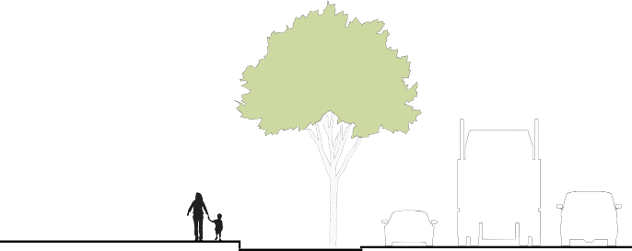







Section K-K: I-35 Southbound Frontage Road Looking North
FUTURE CENTRAL HEALTH BUILDING
EXISTING TREES BEYOND
EXISTING CURB
Building Setback Line Per I-35 Project
Property Line
Existing Curb
10’
10'
7’
7’
Sidewalk
Cycle Track
24'
Bio- Filtration
Existing I-35 Travel Lanes
Sidewalk & Landscape
(Southbound Frontage Road)
Section L-L: Waterloo Promenade at Block 168, Looking North
FUTURE “LINER” BUILDING (70’ DEEP ATTACHED TO
EXISTING GARAGE, BLOCK 168)
EXISTING GARAGE
Existing Grade
497.0’
~496.0
~496.5’ FFE
Healing Garden
Western Edge of Red River Existing ROW
Red River Edge of Existing Curb
Western Limit of Central Health Future Building
Red River Edge of Existing Curb
Eastern Edge of Red River Existing ROW
Waterloo Park
~30'
~20'
~30’
Landscape
Promenade
at Section Cut L-L, at Center of Block 168
Existing Garage
~60'
Existing Red River Curb-to-Curb
~80
Existing Red River ROW
~50
Central Health Open Space Block #3
52 CENTRAL HEALTH BRACKENRIDGE CAMPUS RFQ
70'
“Liner” Building

Slide 61
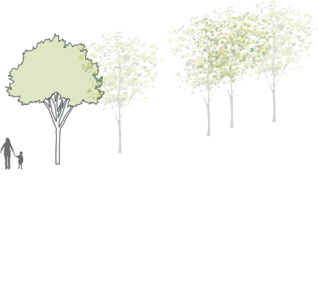
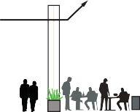



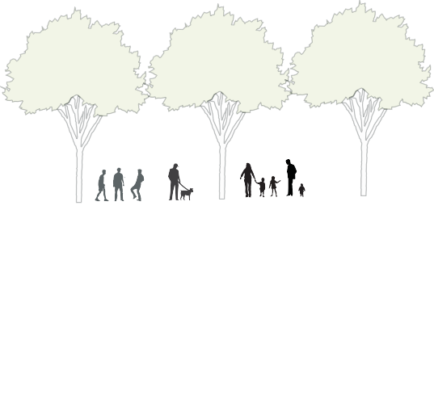


Section M-M: Waterloo Promenade at Block 164, Looking North
FUTURE CENTRAL HEALTH BUILDING (BLOCK 164)
MIN. CLEARANCE
= 15’ 0’’ABOVE FINISHED GRADE
~489.5’
~490’ FFE
~479.5’
Existing Grade
5:1 Slope
Red River Edge of Existing Curb
Red River Edge of Existing Curb
Eastern Edge of Red River Existing ROW
Western Edge of Red River Existing ROW
Western Limit of Future Building
5’ Maximum Building Projection over Promenade
Waterloo Park
30'
35'
Waterloo Promenade 60'
Open Space Block #3
Building Over Cafe Zone
~60'
Existing Red River Curb-to-Curb
~80'
Existing Red River ROW
Section N-N: Waterloo Promenade at 14th St Bridge & Open Space Block #1, Looking North
~491.1’ ~493.1’
~490.5’
Existing 14th Street Bridge
Western Edge of Red River Existing ROW
Red River Edge of Existing Curb
Western Limit of Central Health Future Open Space
Red River Edge of Existing Curb
Eastern Edge of Red River Existing ROW
Waterloo Park
~30' Waterloo Promenade and
Open Space Block #1
Open Space Block #3
~60'
Existing Red River Curb-to-Curb
~80
Existing Red River ROW
SEPT EMBER 1, 2016 www.centralhealth.net/purchasing/bid-sync/ 53

Slide 62
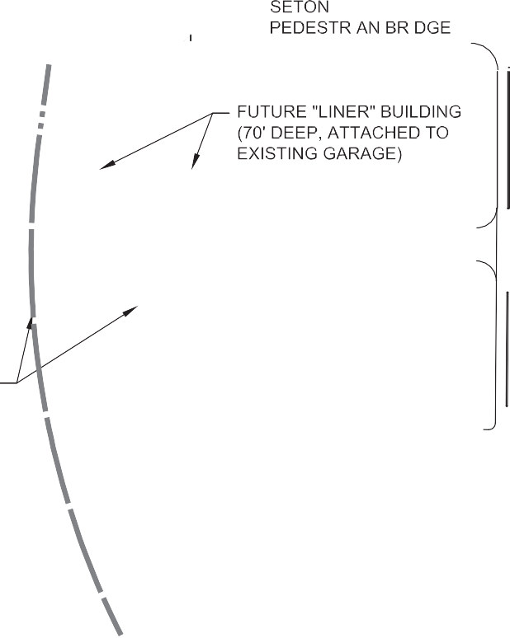

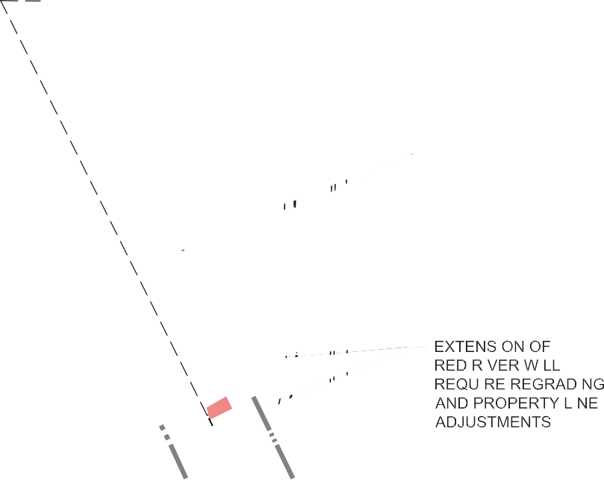



DELL SETON MEDICAL
EAST 15TH STREET
CENTER’S PEDESTRIAN BRIDGE
70’
L
L
BLOCK 168 (EXISTING PARKING GARAGE)
80’
EXISTING MEDIC 3 STATION TO BE RELOCATED
NEW RED RIVER STREET
EXISTING
14TH ST. BRIDGE
OPEN
SPACE
BLOCK
#3
N
OPEN SPACE BLOCK #1
N
WATERLOO PARK
M
BLOCK 164 (FUTURE CENTRAL HEALTH BUILDING)
M
LEGEND
25’ 15’
NEW CENTRAL HEALTH BLOCK PROPERTY BOUNDARIES
EXISTING CENTRAL HEALTH PROPERTY BOUNDARY
EXISTING & PROPOSED ROW/PROPERTY LINES
MAXIMUM OF FUTURE BUILDING ALLOWED WITHIN EXISTING RED RIVER R.O.W.
25 FT-WIDE PORTION OF BUILDING ALLOWED TO EXTEND PAST GROUND FLOOR FOOTPRINT AND OVERHANG PROMENADE WITH MINIMUM VERTICAL CLEARANCE OF 15’-0”
40’
Brackenridge Campus
Waterloo Promenade Layout
0 25 50
100 Feet
54 CENTRAL HEALTH BRACKENRIDGE CAMPUS RFQ

Slide 63
DRAFT AUGUST 22, 2016 www.centralhealth.net/current_solicitations 55

