Slide 1
What Research Says About Recess, Unstructured Physical Activity, and Free Play
2017 Central Health Equity Policy Council
Notes:
Good afternoon. Thank you so much for having us here today. My name is Lyndsi Lambert and this is my colleague Keysha Walcott. We are here today on behalf of the Central Health Equity Policy Council to provide an update on the latest research on recess and unstructured physical activity.

Slide 2
Recess, Unstructured Physical Activity and Free Play
Recess is a time for free play outside of the classroom
Recess is a break during the school day that allows children time for active free play
Recess is unstructured and undirected
Recess provides children with discretionary time and opportunities to engage in physical activity
Recess is a break from the day’s routine allowing a mental change and release of energy
Notes:
Barros, R. M., Silver, E. J., & Stein, R. E. (2009). School recess and group classroom behavior. Pediatrics, 123(2), 431-436.

Slide 3
Recess is an Opportunity for Physical Activity
The Centers for Disease Control and Prevention (CDC) recommends students have opportunities for physical activity outside of physical education class, including “free play” and “recess”
Children can accumulate 40% of their recommended daily physical activity at recess
Austin elementary school students spent 66% of recess period in moderate to vigorous physical activity
Recess contributes to decreased body mass index
Notes:
NOTES:
PA is crucial to preventing obesity
PA improves cardiovascular and musculoskeletal health, mental health, emotional wellbeing
PA improves academic achievement, attention, concentration and classroom behavior
SOURCES:
Institute of Medicine: Koplan JP, Liverman CT, Kraak VI, eds: Preventing childhood obesity: health in the balance. Washington, DC: Institute of Medicine (U.S.); 2005.
Verstraete SJ, Cardon GM, De Clercq DL, et al. “Increasing Children’s Physical Activity Levels During Recess Periods in Elementary Schools: The Effects of Providing Game Equipment.” European Journal of Public Health, 16(4): 415–419, 2006.
Springer AE, Tanguturi Y, Ranjit N, Skala K, Kelder SH. Physical activity during recess in low-income 3rd grade Texas students. American Journal of Health Behavior 2013; 37(3):318-324.
Centers for Disease Control and Prevention. Comprehensive School Physical Activity Programs: A Guide for Schools. Atlanta, GA: U.S. Department of Health and Human Services; 2013.
Centers for Disease Control and Prevention. The association between school based physical activity, including physical education, and academic performance. Atlanta, GA: U.S. Department of Health and Human Services; 2010. http://www.cdc.gov/healthyyouth/health_and_academics/pdf/pa-pe_paper.pdf
Miller DP. Associations between the home and school environments and child body mass index. Social Science & Medicine 2011; 72(5): 677-684.

Slide 4
Recess is an Opportunity to Play
Play is essential for children’s development:
Affects self-control, ability to self-direct, empathy, relaxation and intrinsic control
Improves mood
Reduces stress
Increases social-emotional competence
Improves behavior
Allows choice and freedom
Notes:
NOTES:
Increases social-emotional competence
Allows children to enact roles, builds flexible behavior, promotes empathy/taking others perspectives, encourages cooperation, inhibits antisocial behavior, promotes building closer peer relationships
SOURCES:
Murray, R., Ramstetter, C., Devore, C., Allison, M., Ancona, R., Barnett, S., ... & Okamoto, J. (2013). The crucial role of recess in school. Pediatrics, 131(1), 183-188.
Pellegrini, A. D., & Bohn, C. M. (2005). The role of recess in children's cognitive performance and school adjustment. Educational researcher, 34(1), 13-19.
Ramstetter, C. L., Murray, R., & Garner, A. S. (2010). The crucial role of recess in schools. Journal of School Health, 80(11), 517-526.
American Academy of Pediatrics. Ginsberg, K.R. and the Committee on Communications and the Committee on Psychosocial Aspects of Child and Family Health of the American Academy of Pediatrics. The importance of play in promoting healthy child development and maintaining strong parent-child bonds. Pediatrics. 2007; 119(1), 182-191.
Barros, R. M., Silver, E. J., & Stein, R. E. (2009). School recess and group classroom behavior. Pediatrics, 123(2), 431-436.
Burdette, H. L., & Whitaker, R. C. (2005). Resurrecting free play in young children: looking beyond fitness and fatness to attention, affiliation, and affect. Archives of pediatrics & adolescent medicine, 159(1), 46-50.

Slide 5
Recess is an Opportunity to be Outside
Children are more likely to encounter opportunities for decision making that stimulate problem solving and creative thinking outdoors
Higher amounts of exposure to natural environments (trees, vegetation, plants) is associated with lower levels of stress in children
Notes:
Burdette, H. L., & Whitaker, R. C. (2005). Resurrecting free play in young children: looking beyond fitness and fatness to attention, affiliation, and affect. Archives of pediatrics & adolescent medicine, 159(1), 46-50.
Wells, N. M., & Evans, G. W. (2003). Nearby nature: A buffer of life stress among rural children. Environment and behavior, 35(3), 311-330.

Slide 6
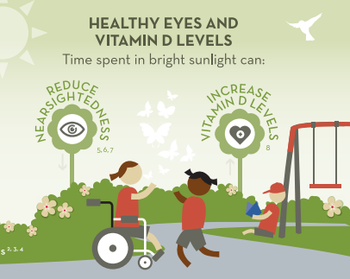

Slide 7
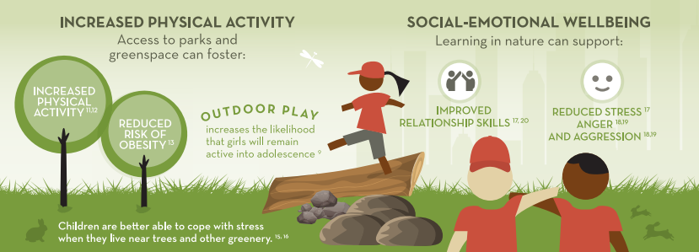

Slide 8
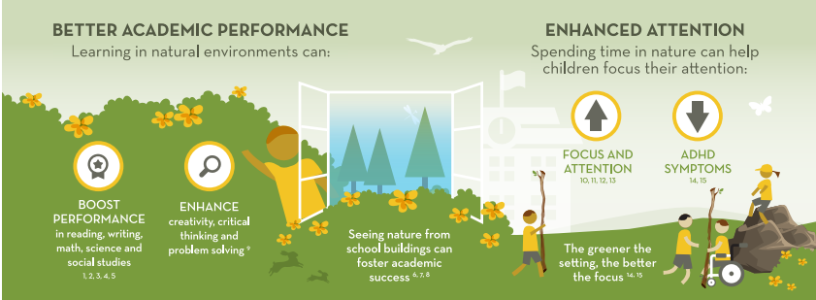

Slide 9
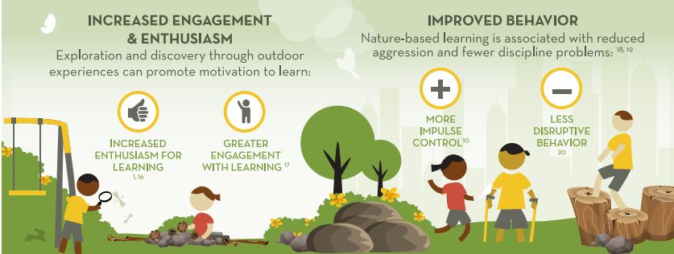

Slide 10
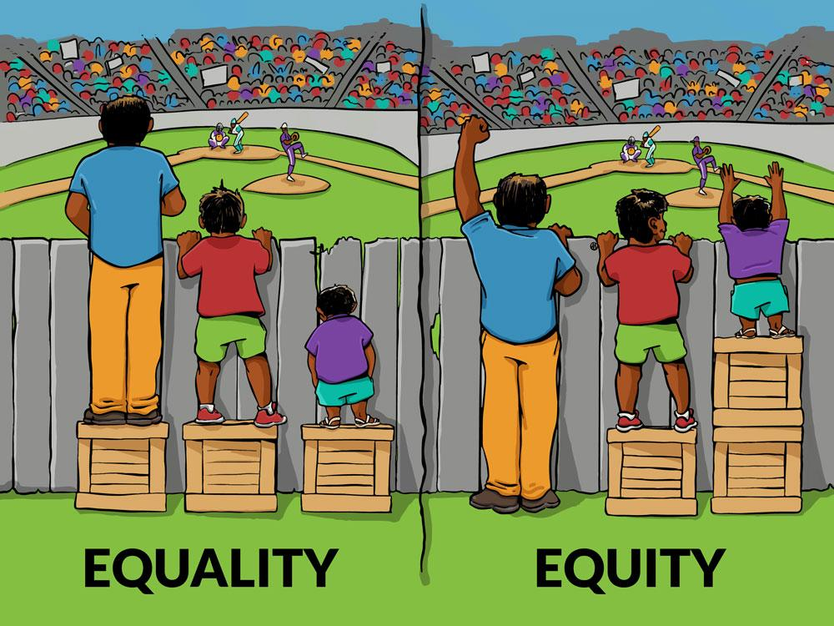
Recess is an Equity Issue
Children at highest risk for obesity are least likely to have recess
Schools with a high percentage of students from low-income families are least likely to have recess
In Austin ISD, 40% of high-poverty schools offered 30 minutes of daily recess vs. 82% of non-Title 1 schools offered 30 minutes of daily recess
Notes:
Active Living Research Center. Increasing Physical Activity through Recess. Robert Wood Johnson Foundation, 2012
Center for Education Statistics, Fast Response Survey System. Washington, DC: United States Department of Education, 2005.

Slide 11
NAME(S) OF PRESENTERS email(s)
Notes:
Active Living Research Center. Increasing Physical Activity through Recess. Robert Wood Johnson Foundation, 2012
Center for Education Statistics, Fast Response Survey System. Washington, DC: United States Department of Education, 2005.

